Slide 1
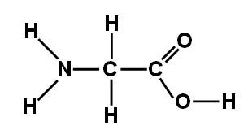
Amino Acid

Slide 2
Fatty Acid

Slide 3
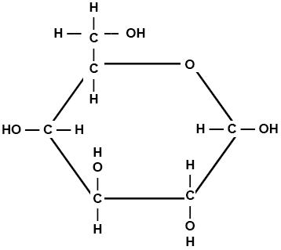
Glucose

Slide 4
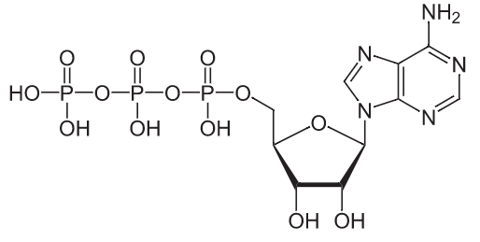
ATP (uncharged)

Slide 5
ATP (charged)

Slide 6
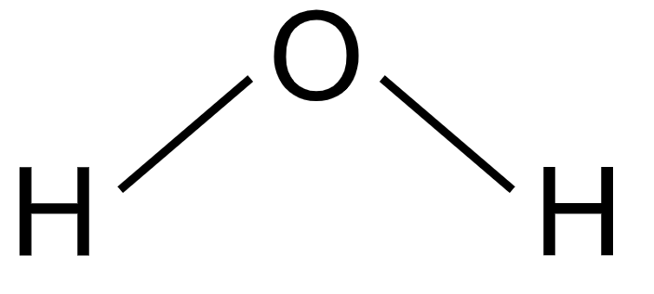
Water Vapor (H₂O)

Slide 7
Carbon Dioxide (CO₂)

Slide 8
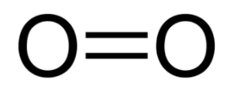
Oxygen (O₂)

