Slide 1
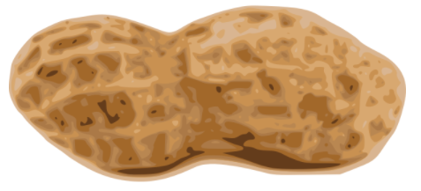


Plants Unit
Week 3 – What happens inside plant cells?
Developed in part from Carbon TIME materials (carbontime.bscs.org). Used with permission.
Notes:
Image Credit: Craig Douglas, Michigan State University
Have students start to think about how cows grow.
Tell students that in today’s activity they will learn about how cows grow through digestion and biosynthesis.
Open 5.1 Tracing the Processes of Cows Growing: Digestion and Biosynthesis PPT.

Slide 2
Plants Unit – W3 Driving Question
This week’s driving question: What happens inside plant cells?
How do plants acquire fat and protein?
How do plants perform biosynthesis?
What are enzymes and how do they enable cells to function?

Slide 3
Part 1 Recap
Earlier we compared the nutrition labels of spinach and peanuts.
We observed that peanuts have high concentrations of fat and protein.
How can a plant acquire fat and protein without consuming other organisms?

Slide 4
Reminders from Earlier Weeks

Slide 5
Remember the following “rules” for energy and matter:
All solids, liquids, and gases are made of atoms.
Multiple atoms can bond together to form molecules.
E.g., water molecules consist of one oxygen atom & two hydrogen atoms.
In biology, atoms last forever.
An atom cannot be created or destroyed or turned into energy. E.g., a carbon atom is always a carbon atom.
However, atoms can be rearranged to form new molecules.
In biology, energy lasts forever.
Energy cannot be created or destroyed.
Energy exists as light, heat, motion, or as chemical energy.
Energy can transform. E.g., light can transform into heat.

Slide 6
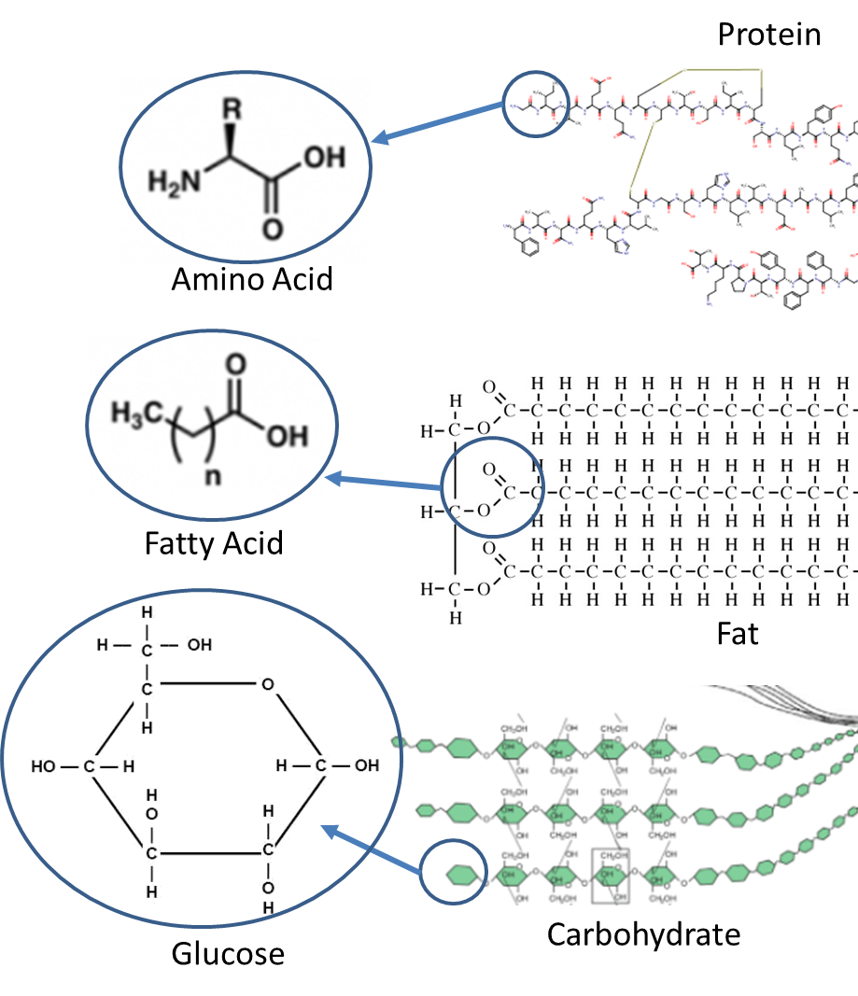
Reminders from Animals
A macromolecule is a long chain of individual molecules bonded together.
  Macromolecules do all the work of cells.
Cells are made from macromolecules.
  Cells form tissues, which form organs, which form systems.

Slide 7
Reminders from Animals
The food that animals consume provides either
1) energy or 2) matter.
  Cellular respiration is the process in which glucose and oxygen molecules are rearranged into CO₂ and H₂O to acquire chemical energy needed to recharge ATP.
  Biosynthesis is the process
  in which organisms use
  consumed molecules to
  make macromolecules
  needed for cell function.
Energy
(CR)
Matter
(BS)
Notes:
Image Credit: Craig Douglas, Michigan State University

Slide 8
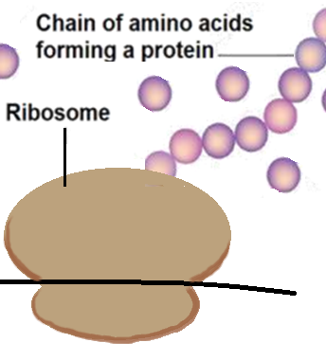
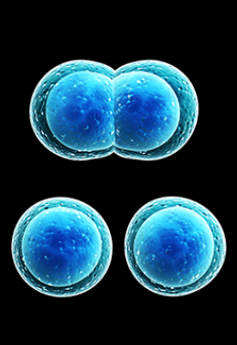
Reminders from Animals
  Biosynthesis is the process in which organisms use consumed molecules to make the macromolecules needed for its cells.
  Cells first absorb individual molecules from the blood.
  Structures inside the cell then assemble individual molecules
  into macromolecules like proteins.
As a cell assembles macromolecules, the cell grows bigger.
  The process of dividing one large cell into two smaller cells is called mitosis.
Source: commons.wikimedia.org

Slide 9
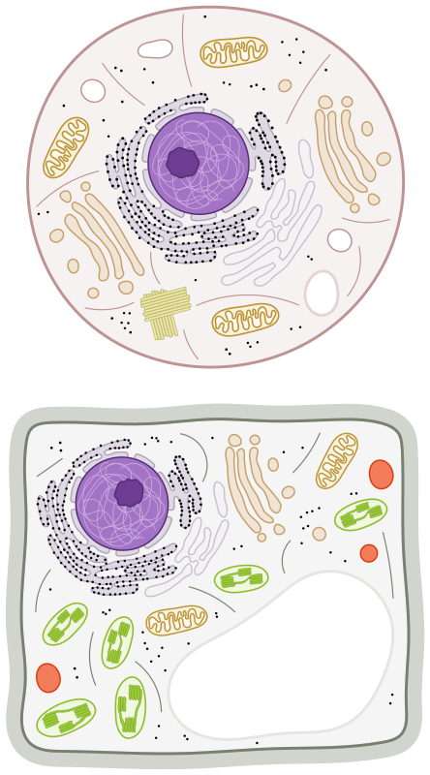
Reminders from Plants, Wk 1
Animal cell
  Most of the organelles found in animal cells are also found in
  plant cells.
    Plant cells also have a nucleus, mitochondria, and ribosomes, among other organelles.
  Plant cells have three organelles that animal cells do not:
    Chloroplasts: where glucose is produced during photosynthesis.
    Cell Wall: a rigid shell made from cellulose.
    Vacuole: a storage organelle for waste products and other molecules.
Mitochondria
Ribosome
Nucleus
Cell Wall
Vacuole
Chloroplast
Plant cell

Slide 10
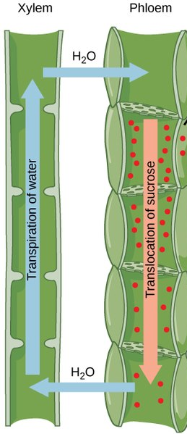
Reminders from Plants, Week 1
  Plant cells are organized like animal cells.
    A group of plant cells form tissues.
    Plant tissues form organs (roots, stems, leaves).
    Plant organs form systems.
  Plant tissues include xylem & phloem.
    Xylem are hollow tubes through which water
    and minerals move up through the plant as
    water is evaporated from pores in the leaves.
    Phloem are tubes through which sugars move
    down throughout the plant via gravity.
    Xylem & phloem in roots, stems, and leaves
    form a vasculature system (like the circulatory
    system in animals).
Notes:
Note – not all plants have xylem and phloem vasculature. Examples include liverworts and mosses. However, these plants are very limited in how large they can grow and depend on specific conditions to enable their cells to acquire a sufficient supply of matter and energy through biosynthesis and cell respiration. Similarly, algae are single-celled photosynthetic organisms that lack vasculature because they can acquire or produce all needed substances within a single cell.

Slide 11
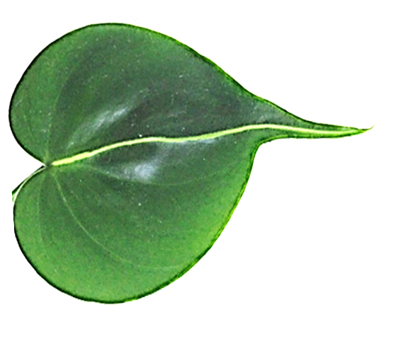
Photosynthesis simplified…
CO₂
1. Evaporation pulls water up the xylem tubes into the leaves of the plant.
2. CO₂ is absorbed through pores in the leaves.
3. CO₂ and H₂O are rearranged to form glucose (C₆H₁₂O₆) and oxygen (O₂) using light energy.
4. O₂ is released. Glucose is used for cell resp. or biosynthesis.
2
O₂
1
`
3
Xylem
Glucose
4
`
H₂O
`
Phloem

Slide 12
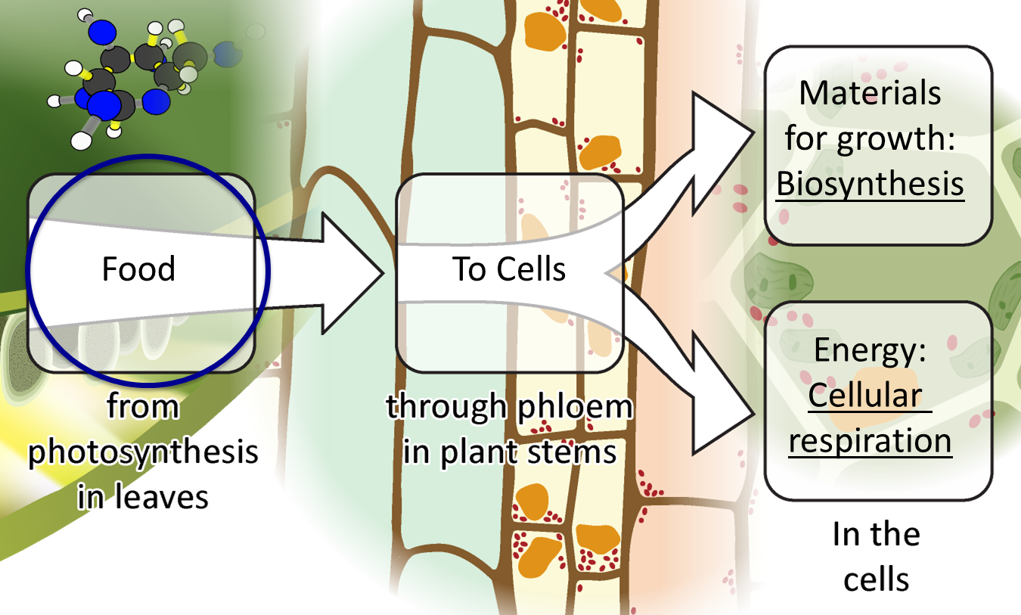
  Plants use some glucose produced during photosynthesis to recharge ATP during cellular respiration.
    This can occur within that cell or glucose can travel to other cells.
  Glucose can be used in multiple forms of biosynthesis.
    Glucose can be assembled into long chains to form cellulose.
    Atoms in glucose can be rearranged with minerals from the soil to form amino acids, fatty acids, etc.
Notes:
Image Credit: Craig Douglas, Michigan State University
Use the Plants in the Light and Dark investigation results to ask about how plants make their own food.
Display slide 4 of the PPT. Remind students of the results of the Plants in the Light and Dark investigation: The plants in the light changed the BTB solution to blue, which indicated a decrease in CO₂. The plants in the dark changed the BTB solution to yellow, which indicated an increase in CO₂. The carbon must be going to and coming from somewhere around the plants.
Discuss the diagram on slide 4, which shows that food made in the leaves is needed for both growth and movement. Explain that modeling photosynthesis will help them understand the results of the investigation.
Display slide 5 of the PPT. Use the animation to support students in connecting the atomic-molecular scale to the macroscopic scale.
Tell students they will be modeling the change that occurs during cellular respiration at the atomic-molecular scale.

Slide 13
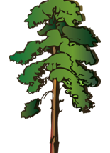
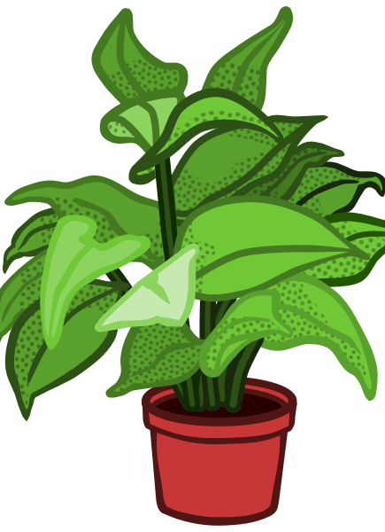
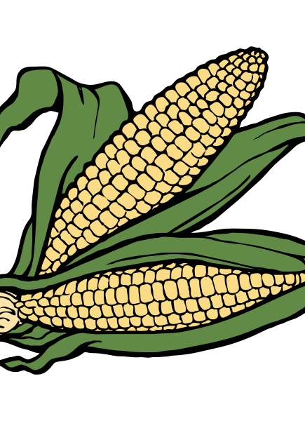
Biosynthesis & Enzymes

Slide 14
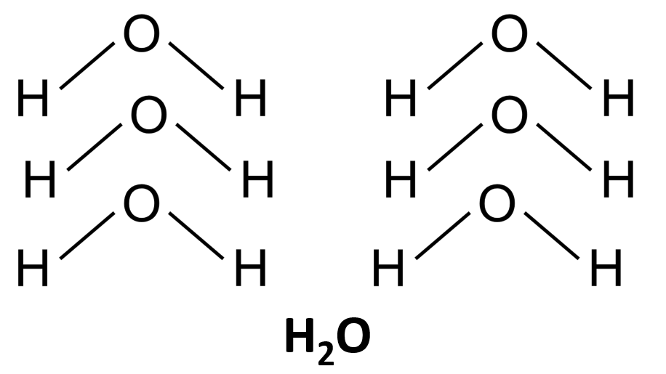
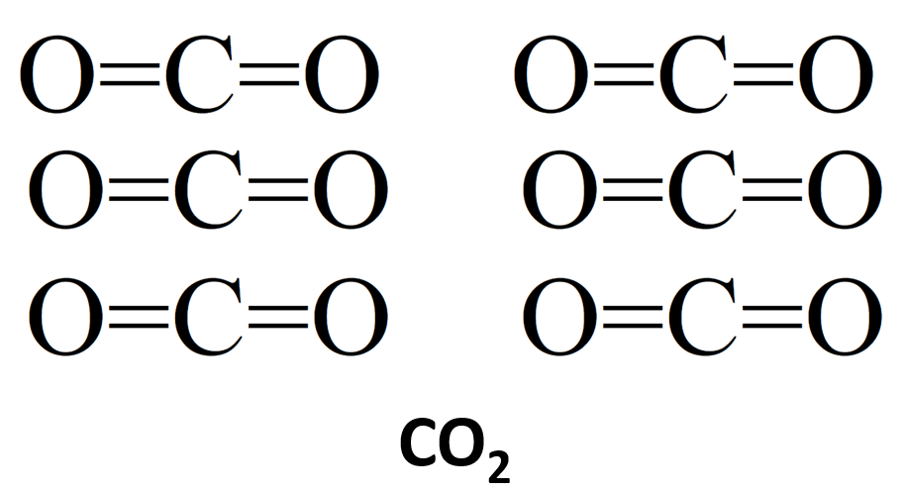
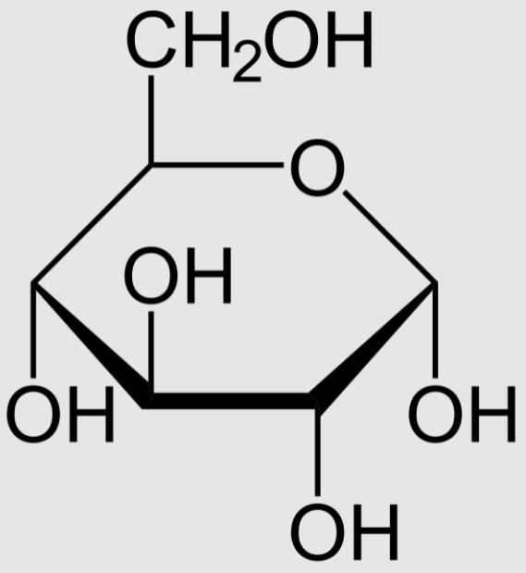
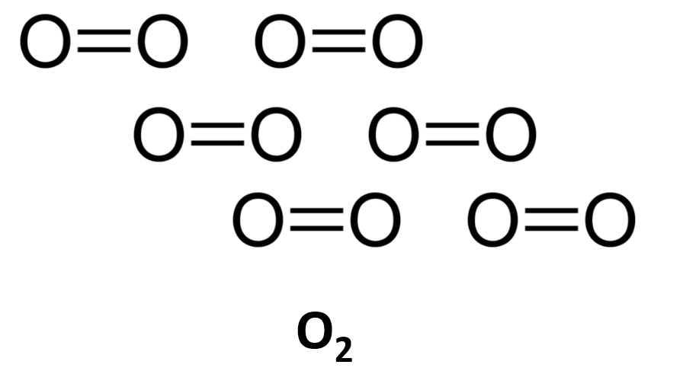
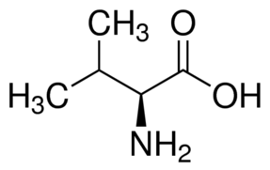
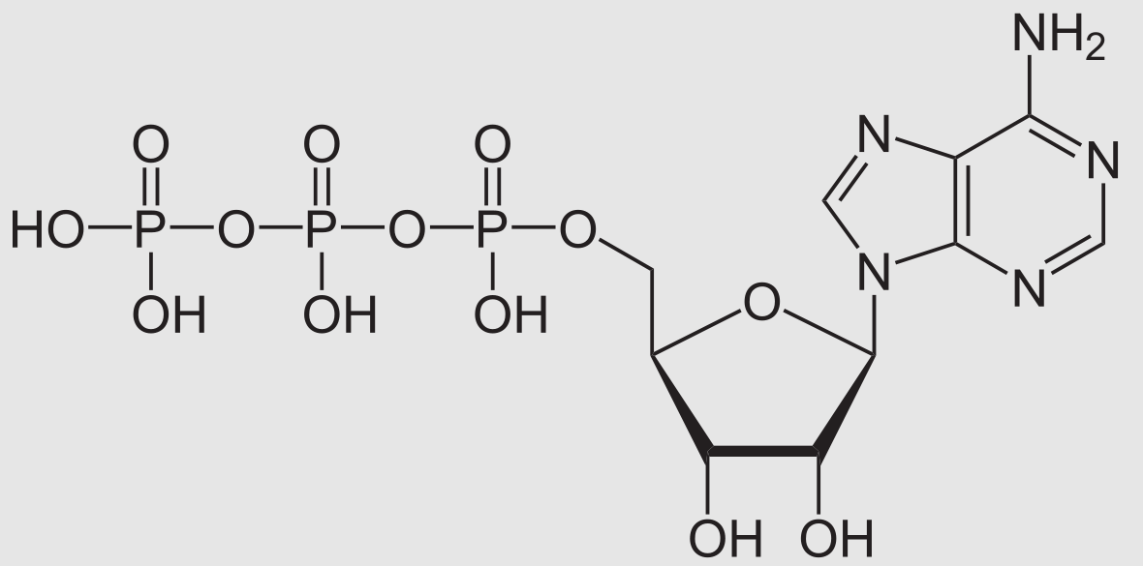
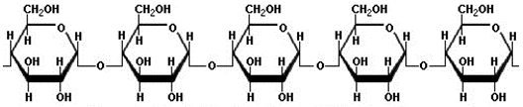

It starts with glucose…
  Plants are generally unable to consume other organisms.
    Plants must be able to produce all the molecules that they need within their cells.
  All carbon-based molecules in plants begin as glucose molecules.
    Through biosynthesis, plants produce all the molecules that their cells need to function from glucose molecules.
Notes:
Technically, a molecule called G3P that is a precursor to glucose is the basis for all molecules found in the plant cell. We have opted to oversimplify this claim to enable students to grasp the concept that biosynthesis in plant cells is capable of producing all of the molecules that a plant cell needs.

Slide 15
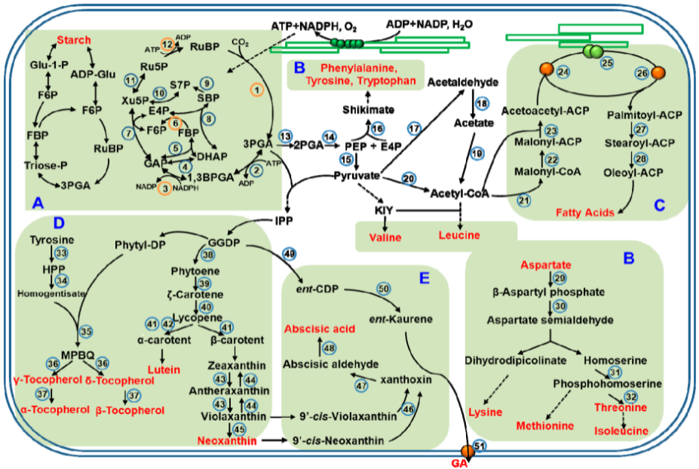
  Plant biosynthesis begins in the chloroplasts.
    Enzymes in the chloroplast can assemble glucose molecules into starch and cellulose macromolecules.
    Chloroplast enzymes can also rearrange atoms in glucose and soil minerals to make fatty acids and amino acids.
Source: Chen, et al., 2018

Slide 16
Plant Biosynthesis
Source: Chen, et al., 2018
CO2 is absorbed
Notes:
The blue arrow indicates where CO2 is absorbed. CO2 and H2O are rearranged into glucose and oxygen during the Calvin Cycle (steps 1-12). Glucose can then be assembled into starch (upper left), into fatty acids (upper right), or into amino acids (remaining red-lettered items). Glucose can also be assembled into nucleic acids to reproduce DNA for the plant cell nucleus.

Slide 17
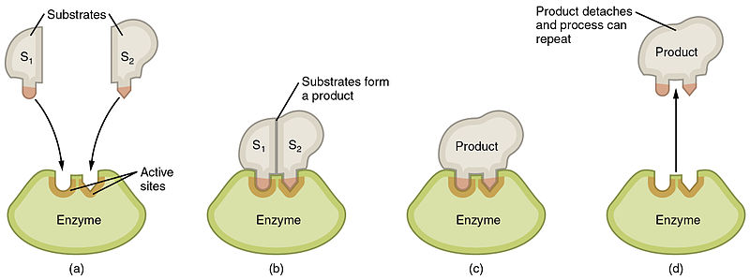
Enzymes
  All cells, including plant cells, depend on enzymes to rearrange atoms in molecules to form new molecules.
    Enzymes are specialized proteins that enable molecular reactions to occur more quickly and easily.
    Enzymes reduce the amount of energy (ATP) and time needed for a reaction to occur within an organism.
    Enzymes enable new molecules to be formed but are not part of the molecules that are produced during a reaction.
In this image, two molecules are joined together to form a new macromolecule by an enzyme.
Source: Wikimedia Commons

Slide 18
Monomers & Polymers
  Enzymes can create larger, smaller, or different molecules depending on their function.
    A) Some enzymes assemble individual molecules (monomers) into large repeating chains (called macromolecules or polymers).
    B) Some enzymes disassemble long polymers into individual monomers.
    C) Some enzymes rearrange atoms to form entirely new molecules.
Short Monomers
Long Polymer
C
A
B
Long Polymer
Short Monomers
Forming a new molecule
Notes:
We generally use the terms “macromolecule” and “polymer” interchangeably. However, technically lipids are not polymers because they are assembled from a combination of molecules (usually three fatty acid molecules and a glycerol molecule). While our explanation is not fully accurate, we believe this explanation better supports student reasoning about a complex topic and that the detail needed for a fully accurate explanation would serve as a barrier to understanding among many students.

Slide 19
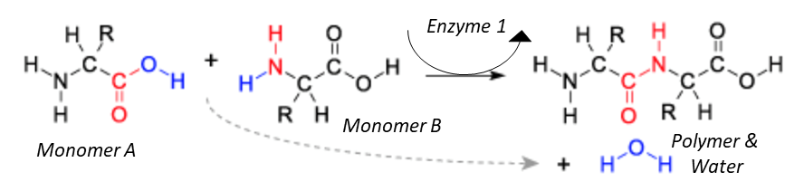
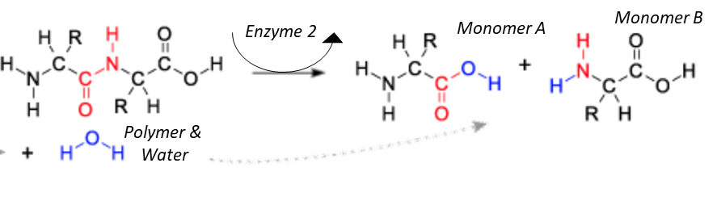
Monomers & Polymers
  Enzymes can combine short monomers to form long polymers
  by removing oxygen and hydrogen atoms.
    These atoms combine to form a separate water molecule.
  Similarly, enzymes can break apart long polymers by “inserting” a water molecule between each monomer.
    This causes the bond between the monomers to break apart.

Slide 20
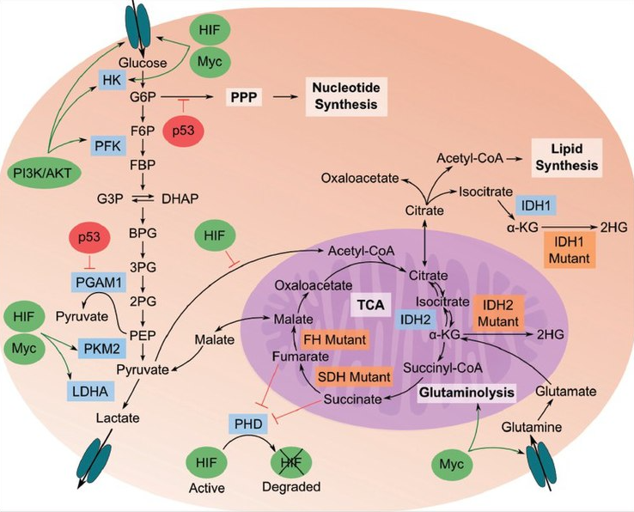

  Some enzymes in eukaryotic cells rearrange the atoms in glucose with minerals like nitrogen or phosphorus. This forms new molecules like fatty acids, amino acids, and ATP.
Glucose
Source: https://commons.wikimedia.org/wiki/File:TumorMetabolome.jpg?scrlybrkr=8adfb6f9
Mitochondria

Slide 21
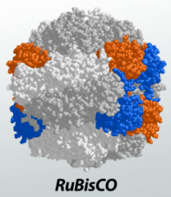
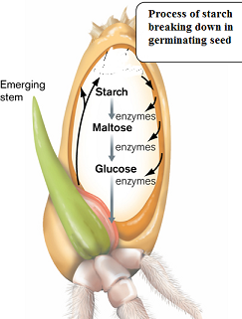
Enzymes
Source: Study.com
  Enzymes are critical for the function of plant cells.
    For example, Rubisco is an enzyme in chloroplasts that is needed for photosynthesis.
    Rubisco adds carbon atoms from CO₂ to the atoms from H₂O to assemble a glucose molecule.
    Another enzyme, called starch synthase, can then assemble glucose monomers into starch polymers.
  Some plant enzymes can disassemble
  long polymers into short monomers.
    For example, the starch in plant seeds provides
    a source of chemical energy as a seedling grows.
    An enzyme called amylase breaks down starch polymers into glucose monomers.
    This enables the seedling’s mitochondria to use chemical energy from glucose to recharge ATP.
Image Source: IGCSE

Slide 22
  1. Carbon dioxide (CO₂) and water (H₂O) are absorbed into the chloroplast of a plant cell.
  2. The enzyme Rubisco adds carbon from CO₂ to the atoms from H₂O to create glucose.
Cell Wall
Cell Membrane
Chloroplast
`
Glucose
  3. If a plant needs to assemble starch, the enzyme starch synthase combines glucose molecules by removing H & O atoms, forming starch and water.
Starch

Slide 23
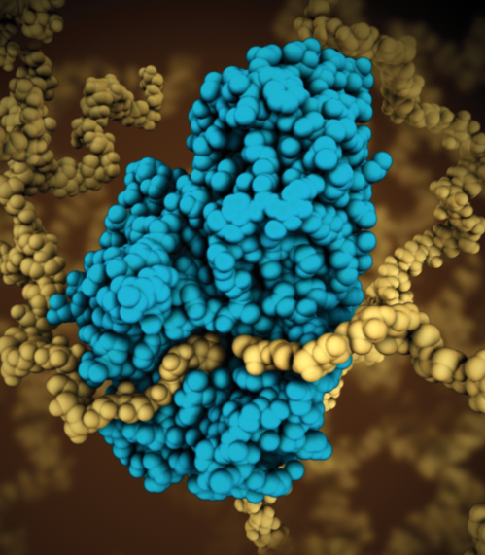
Animal Enzymes
  Like plant cells, animal cells also depend on
  enzymes to function.
    For example, enzymes in the digestive tracts of
    animals break down carbohydrate polymers into
    individual glucose monomers.
    Digestive enzymes include amylase in animal saliva,
    which breaks starch into separate sugar molecules.
  Animal cells can also have enzymes that
  assemble monomers into polymers.
    For example, fatty acid synthase consists of multiple enzymes that assemble fat polymers using molecules from consumed food.
    Fatty acid synthase enables animal cells to convert carbohydrates and protein into fat, allowing the cell to store energy for later use.
The amylase enzyme, found in plants & animals, breaks starch polymers into glucose monomers.
Carbohydrates
Glucose
Fatty Acid
Acetyl-CoA
Fatty Acid
Fatty Acid
Protein
Amino Acids
Fatty Acid
Notes:
Acetyl CoA is an intermediary molecule produced after glucose has been broken into two pyruvate molecules. A carbon atom is then removed from each pyruvate, forming a 2-carbon molecule that eventually forms Acetyl-CoA. Acetyl-CoA can then be formed into a wide variety of other molecules, including fatty acids, amino acids, and carbohydrates.

Slide 24
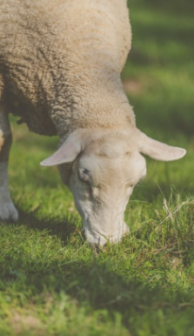
Plant & Animal Interactions
  Cellular reactions affect how species interact with each other.
    For example, when animals consume plants, enzymes in their digestive tracts disassemble the macromolecules (polymers) from plant cells into the individual monomers.
    Animal cells then reassemble the monomers into polymers OR their cells rearrange the atoms in monomers to make other molecules needed by the cell OR their cells rearrange plant molecules and oxygen into CO₂ and H₂O during cellular respiration.
Source: Public Domain Pics

Slide 25
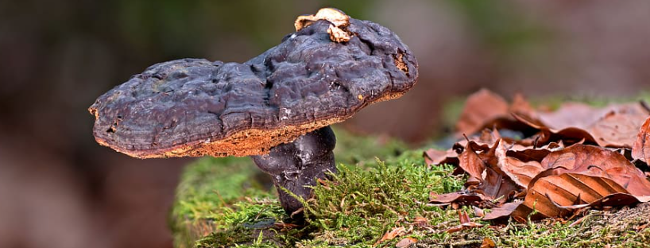
Decomposers
  Decomposers (such as fungi like mushrooms as well as bacteria) can also use enzymes to break down the dead or dying tissues from organisms like plants and animals.
    These enzymes break down polymers into monomers.
    Decomposers can then absorb and reassemble into the macromolecules needed by their cells OR use monomers during cellular respiration (especially glucose and fatty acids).
    Decomposers eventually convert most carbon-based molecules with high-energy bonds back into CO₂ and H₂O.
Source: Pixfuel

Slide 26
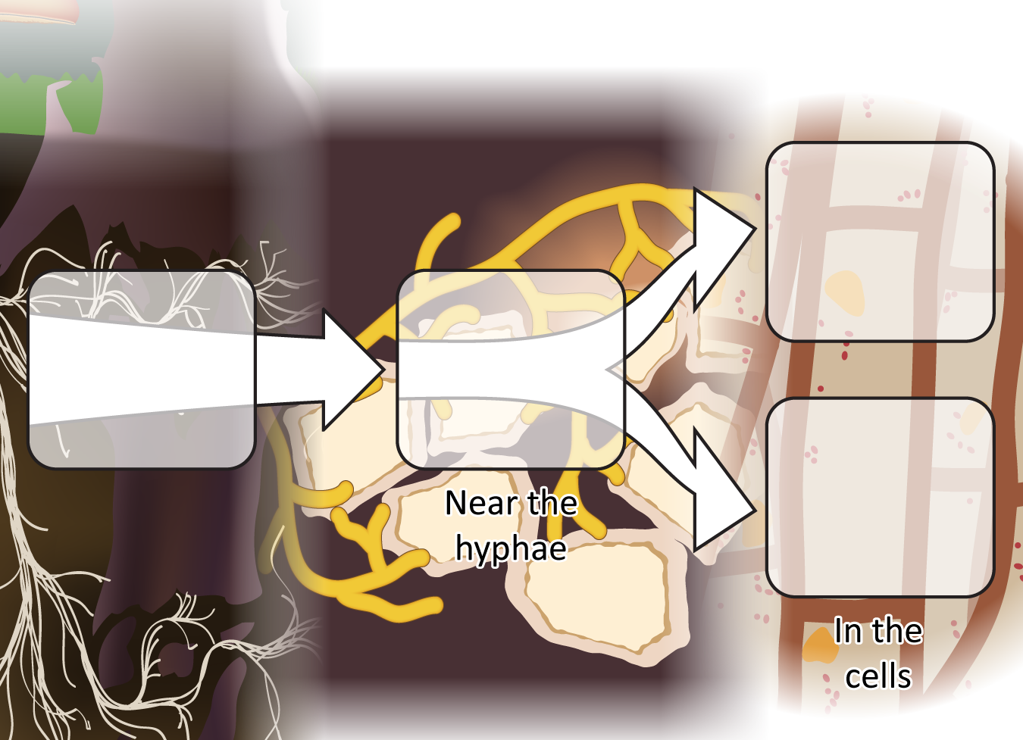
Decomposer cells use digested food in two ways
Materials
for growth:
Biosynthesis
Food
(dead
tissue)
Digestion
via enzymes
Energy:
Cellular
respiration
Notes:
Review the ways in which decomposers use food.
Use Slides 3-6 of the PPT to review what students have figured out about how decomposers use food.
Slide 6 reminds students that after food is digested outside the decomposers the molecules can either be used for growth through biosynthesis or to obtain energy through cellular respiration.
Tell students that their explanations today will be to tell this whole story for other types of decomposers.
Image Credit: Craig Douglas, Michigan State University

Slide 27
Revising Our Claims
Revisit this week’s driving question: What happens inside plant cells?
We observed that peanuts have high concentrations of fat and protein.
How can a plant acquire fat and protein without consuming other organisms?
Revise your explanation using the following terms: enzymes, monomers, polymers.

Slide 28
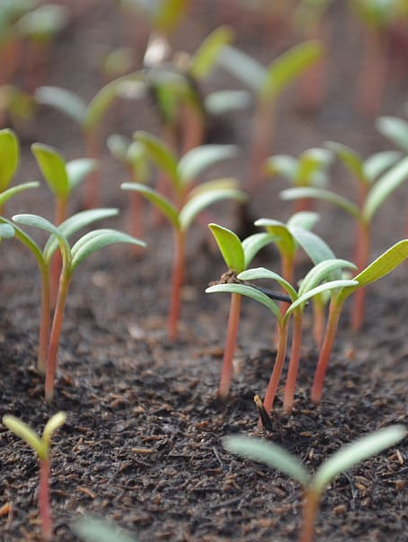
Looking Ahead: Part 3 Investigation
In Part 3, you will be investigating what kinds of pigments are found in plant cells and determining how these pigments were formed.

