Slide 1
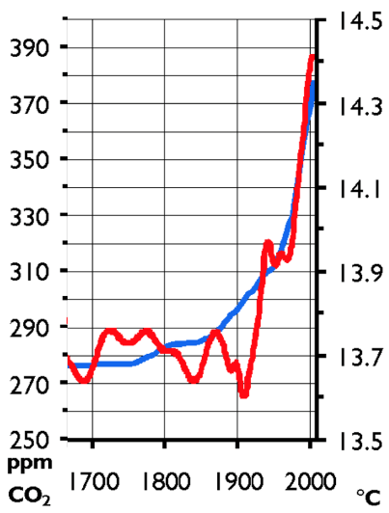


Ecosystems Unit
Week 2 – How do imbalances cause ecosystem disturbances?
Developed in part from Carbon TIME materials (carbontime.bscs.org). Used with permission.
Notes:
Image Credit: Craig Douglas, Michigan State University
Have students start to think about how cows grow.
Tell students that in today’s activity they will learn about how cows grow through digestion and biosynthesis.
Open 5.1 Tracing the Processes of Cows Growing: Digestion and Biosynthesis PPT.

Slide 2

Ecosystems Unit – W2 Driving Question
How do imbalances in matter and energy cause ecosystem disturbances?
How do ecosystems enable matter movement and energy transformation?
How do imbalances in matter and energy occur?
What happens when matter and energy are unbalanced?
How does human activity relate to these kinds of disturbances?

Slide 3
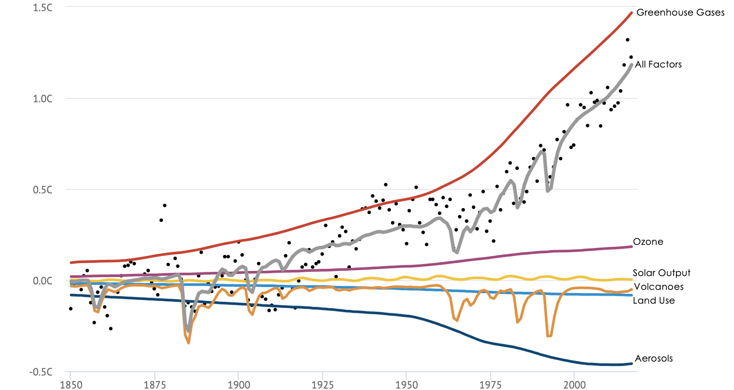
Part 1 Recap
Earlier we investigated how carbon dioxide and temperature are related.
We determined that there is a correlation between levels of CO₂ and changes in temperature.
We also observed that increases in average temperatures correlate with increases in carbon dioxide since the Industrial Revolution.

Slide 4
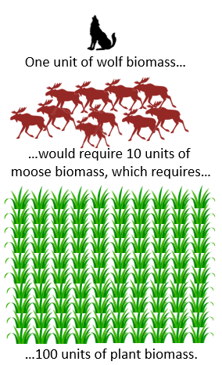
Recap of Week 1
Ecosystems are the interactions between organisms and the non-living aspects of their environment.
Rates of photosynthesis and the 10% Rule determine the carrying capacities of ecosystems.
  Warmer, wetter, sunnier environments can support greater rates of photosynthesis.
  More plant biomass production supports greater amounts of consumers like animals.
  Carrying capacity = number of species a habitat can support.
  A disturbance is anything that interferes with the movement of matter and the flow of energy.

Slide 5
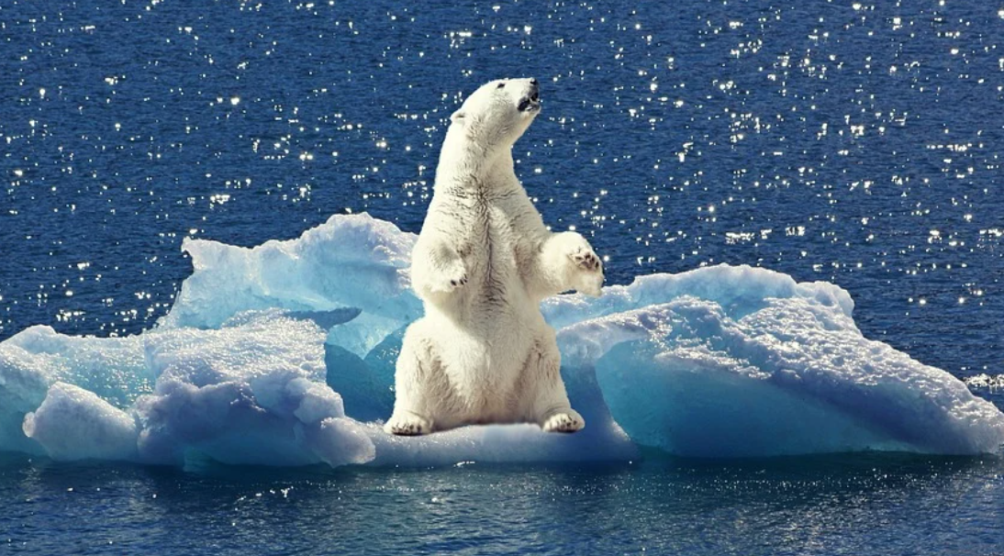
Matter & Energy Imbalances and ecosystem Disturbances
Image Source: Pixabay

Slide 6
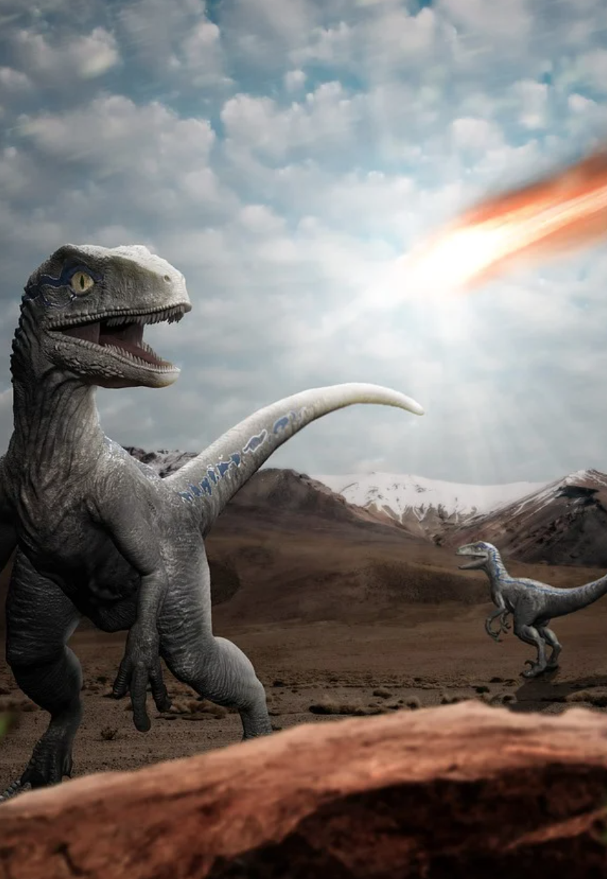
Imbalances = Disturbances
Disturbances reduce the carrying capacity of ecosystems by disrupting the matter movement and energy transformation.
  For example, an asteroid strike caused the extinction of the dinosaurs by reducing rates of photosynthesis.
  The asteroid strike released large clouds of dust into the atmosphere, reducing the amount of light available for photosynthesis.
  This reduced the rate of plant biomass production, reducing carrying capacities and causing widespread extinction.
Image Source: Pixabay
Notes:
Note: this is not necessarily a settled science, and significant debate is still occurring as to the rate at which the dinosaurs went extinct. Example news articles: https://news.yale.edu/2011/07/12/last-dinosaur-mass-extinction-discovered

Slide 7
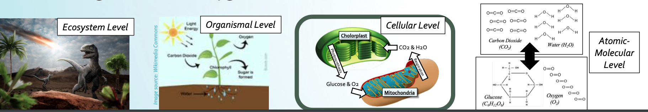
Changes Across 4 Levels
The effects of an asteroid hitting earth resulted in the extinction of 80% of species due to changes at four levels.
  The asteroid created large clouds of dust that blocked out sunlight (ecosystem level).
  This affected individual plants (organismal level) because it interrupted their ability to photosynthesize (cellular level).
  This reduced the production of glucose and O₂ from CO₂ and H₂O molecules (atomic-molecular level).
Reductions in rates of photosynthesis reduced the production of plant biomass, reducing ecosystem carrying capacities.

Slide 8
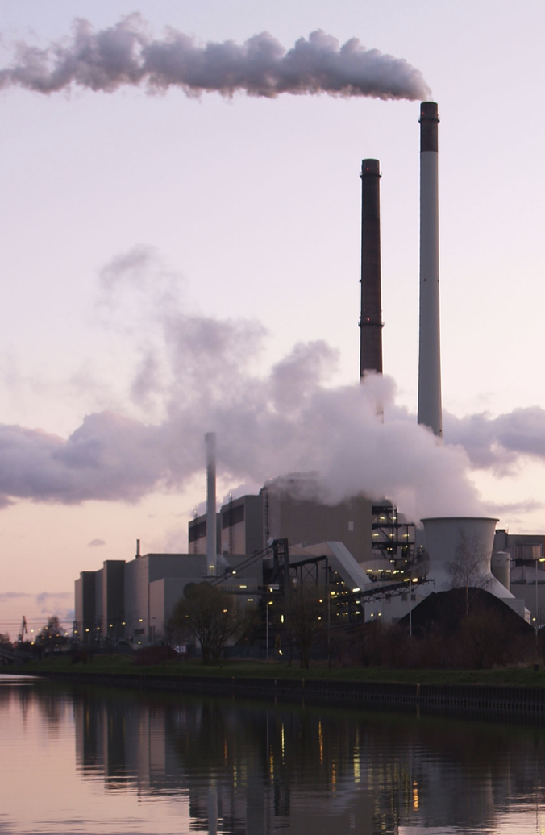
Imbalances = Disturbances
Disturbances can also occur if rates of cell respiration, decomposition, or combustion increase relative to rates of photosynthesis.
  This causes biomass to be converted into CO₂ and H₂O faster than it can be reabsorbed.
Currently, the rate of CO₂ emissions exceeds the amount absorbed through photosynthesis.
  This is primarily due to widespread fossil fuel combustion since the start of the Industrial Revolution in the mid-1800s.
Source: Wikipedia

Slide 9
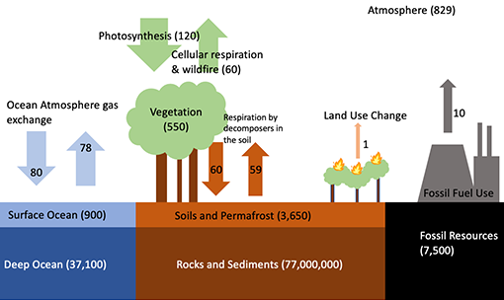
Source: Carbon TIME
This shows the movement of carbon atoms as a result of photosynthesis, respiration, decomposition, and combustion (as well as passive movement into/out of oceans). The movement of carbon atoms is mostly balanced, but combustion of fossil fuels creates imbalances. As a result, more carbon atoms move into the atmosphere as CO₂ than can be absorbed in photosynthesis.

Slide 10
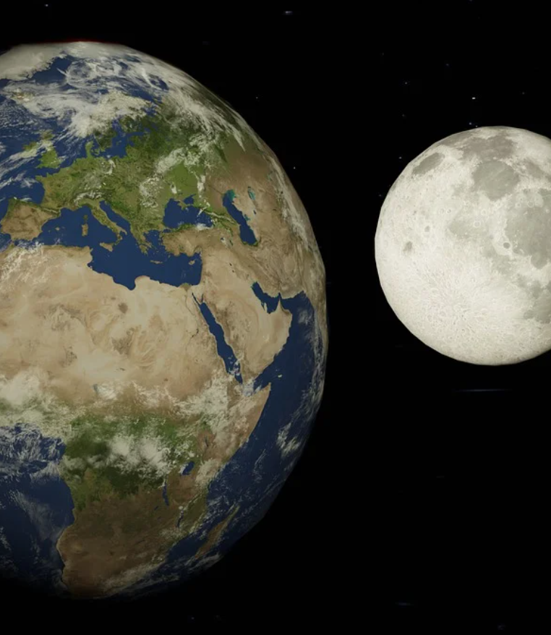
CO₂ = Temp Regulator
Image Source: Pixabay
CO₂ plays a major role in regulating the earth’s surface temperatures.
  Case in point: both the earth and the moon are roughly the same distance from the sun but have very different surface temperatures.
  The moon ranges from -300º F to 225º F due to a lack of gases like CO₂.
Gases like CO₂ slow the loss of heat.
  This moderates the earth’s surface temperatures within a range that allows life to exist.
Due to its small size, the moon
lacks an atmosphere with CO₂.
As a result, temps on the moon
fluctuate between -300º – 225º F

Slide 11
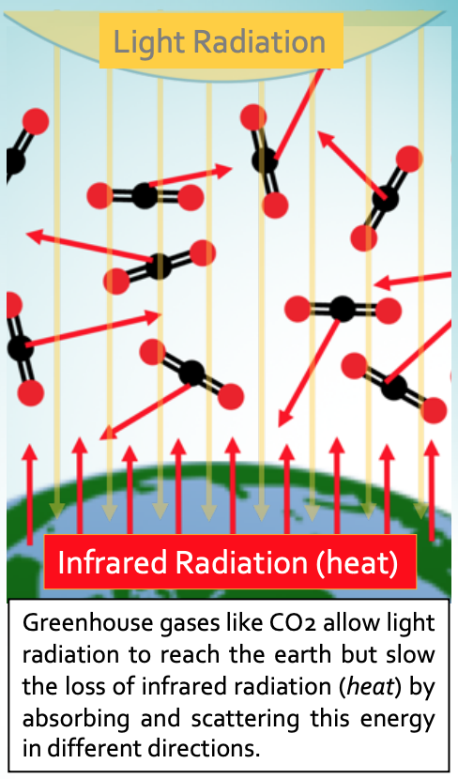
Greenhouse Gases (GHG’s)
Greenhouse gases (GHG’s) like CO₂ allow light to reach the surface of the earth but slow the loss of heat energy (a condition known as the greenhouse effect).
  This is also why a car’s interior warms up on a sunny day – light can enter through glass more easily than heat can escape.
  While the greenhouse effect is needed to support life, excess GHG’s are problematic (like wearing a winter jacket in July).
  While CO₂ is only a small proportion of the earth’s atmosphere, it is the most abundant greenhouse gas.

Slide 12
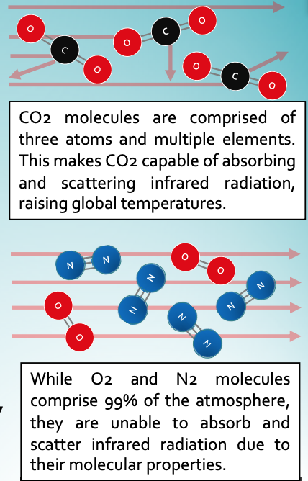
Absorbing & Re-emitting Heat
  For a molecule to be a greenhouse gas, it must absorb and scatter infrared radiation (the kind of energy we feel as heat).
  To do this, it must…
  1. Have more than two atoms.
  2. Have two or more elements.
  The molecular structure of CO₂ enables it to absorb infrared radiation and re-emit it.
  The greater the concentration of CO₂, the more slowly heat escapes into space.
  As CO₂ levels rise, infrared radiation will stay in the atmosphere for longer periods, raising surface temperatures.
Notes:
Water vapor is also a greenhouse gas. However, water stays in the atmosphere for far less time than CO2. As such, our emphasis in this presentation is on CO2 due to its role as the primary greenhouse gas in the atmosphere.

Slide 13
Is This Just a Natural Cycle?
Milankovitch Cycles
The changes occurring today are far too rapid to be the result of natural cycles.
  Variations in the Earth’s orbital path and tilt (called Milankovitch Cycles) change how much solar radiation reaches the earth.
  This changes global temperatures.
  The length of these cycles occur range from 26,000 years to 100,000 years.
Current changes to climate have occurred in less than 200 years.
  This indicates that factors other than the earth’s natural climate cycles are responsible for recent warming trends.
Circular Orbit vs. Oval Orbit
Cycles last 100,000 years.
Less Axial Tilt vs. More Axial Tilt
Cycles last 41,000 years.
Less Wobble vs. More Wobble
Cycles last 26,000 years.

Slide 14
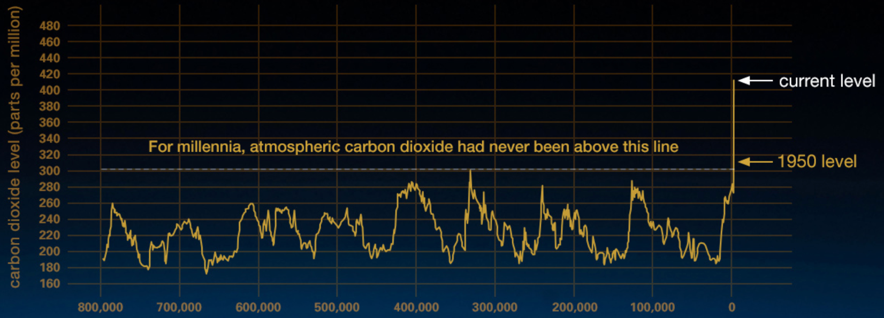
Unprecedented Spikes in CO2
Atmospheric CO₂ levels have increased by more than 50% since the Industrial Revolution mostly because of fossil fuel combustion.
  In the entire time that humans have existed as a species, there has never been another time in which CO₂ concentrations have this high or have increased at this rate.
  Climate change refers to ecological disturbances resulting from excessive CO₂ levels in the atmosphere due to human activity.
Source: NASA Climate Change
Notes:
It can be helpful to point out that anatomically modern humans as a species are roughly 200,000 years old. The data above gives us a snapshot for what “natural” variations in CO2 look like. With or without modern humans, CO2 levels never exceeded 300 ppm prior to the Industrial Revolution.

Slide 15
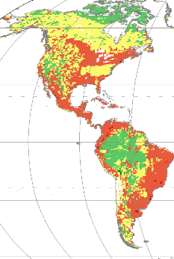
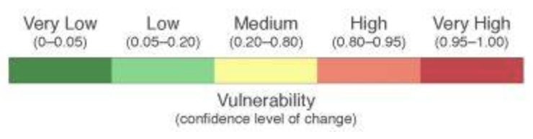
Ecosystem Disturbances
Changes due rising CO₂ levels are causing significant ecosystem disturbances.
  A warming climate results in changes in vegetation, displacing the species that depend on that vegetation.
  Most of North American habitats are vulnerable due to climate change.
Some species are directly impacted by warming.
  For example, fish like salmon and trout depend on cool water, as warmer water has less dissolved oxygen.
  As their aquatic habitats warm, they are unable to migrate to new regions with colder water and sufficient oxygen.
Source: https://phys.org/news/2014-07-europe-habitat-wildlife-vulnerable-climate.html?scrlybrkr=dd68cb79

Slide 16
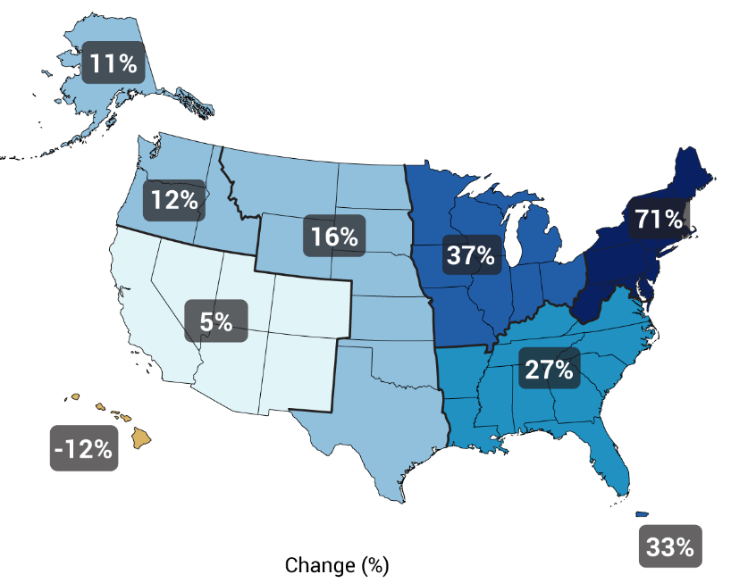
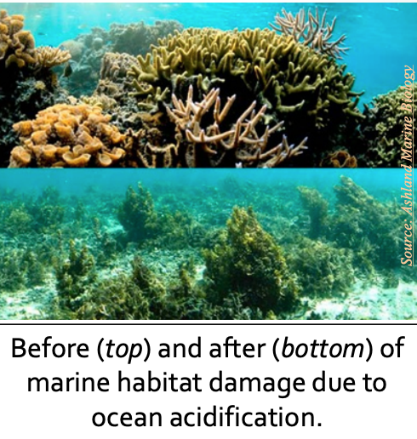
Flooding, Droughts, & Acidity
Source: National Climate Assessment - GlobalChange.gov
Changing greenhouse gas concentrations also changes precipitation patterns.
  A warmer atmosphere can hold onto more moisture for longer timeframes.
  This increases the frequency of both droughts and flooding.
Increasing levels of CO₂ also result in more acidic conditions in marine ecosystems.
  As more CO₂ dissolves in water, it forms carbonic acidic that can harm marine ecosystems such as coral reefs.
  This can have significant ramifications as most photosynthesis (70%) occurs in aquatic ecosystems.
Changes in Heavy Precipitation
Source: FACTS
Notes:
70% of photosynthesis occurs in marine plants - https://www.nationalgeographic.org/activity/save-the-plankton-breathe-freely/

Slide 17
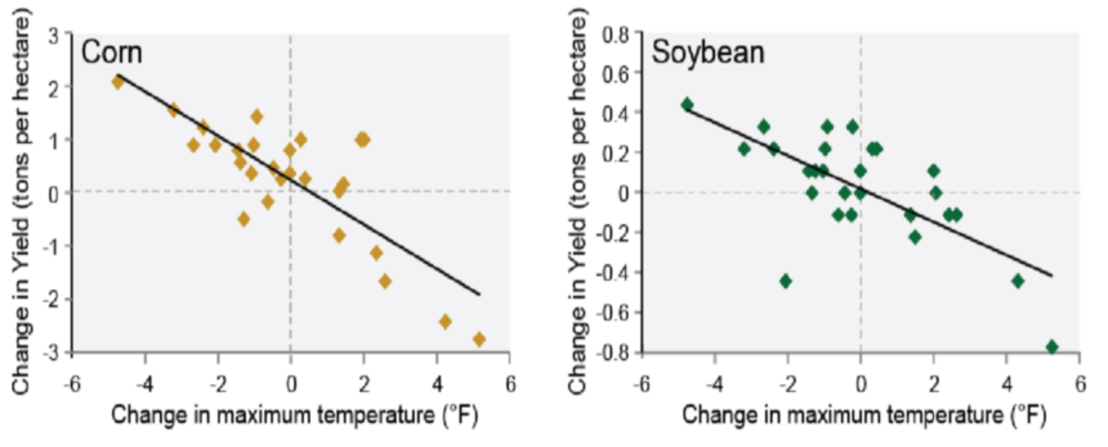
Impacts on Agriculture
  Rising CO₂ levels impact a wide variety of human activity, particularly agriculture.
    An increase of a few degrees in the maximum summer temperature reduces corn yields by 1-3 tons per acre (Pryor et al., 2014)
    The US dairy industry loses $670 million annually due to climate change (Mauger et al., 2015)
    Increasing the summer growing season by a single day results in a 7.6% reduction in US wheat yields (Tack et al., 2015)
    Early thaws cause hundreds of millions of dollars in losses to fruit & berry crops
    (Hatfield & Tackle, 2014)
Crop yields are very
sensitive to changes in
temperatures. Increasing summer temps reduce yields per acre by tons.
(Pryor et al., 2014)

Slide 18
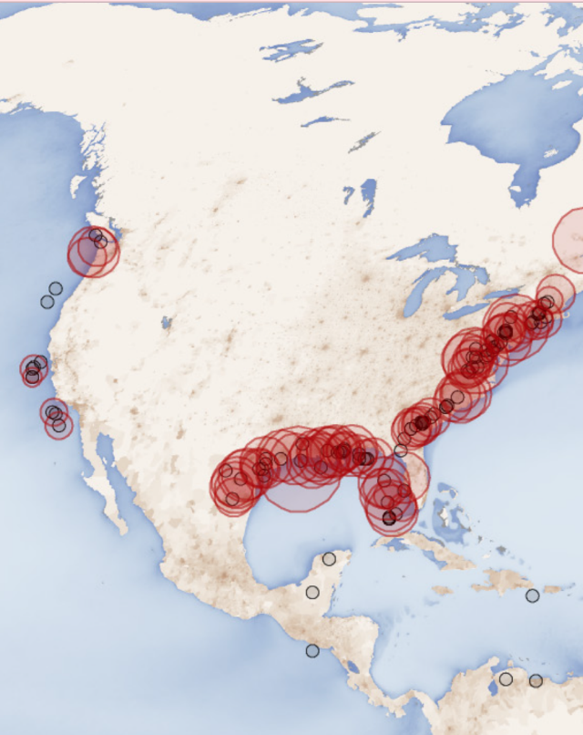
N & P Imbalances
  Human activity causes other imbalances, particularly nitrogen & phosphorus.
    Fertilizer runoff from fields and yards results in eutrophication in aquatic ecosystems.
  Eutrophication occurs when dissolved oxygen in aquatic ecosystems is reduced due to excess levels of nitrogen & phosphorus.
    Nutrient runoff increases surface algae growth, blocking light for underwater photosynthesis.
    Impaired photosynthesis and increased decomposition reduces aquatic oxygen levels.
  This results in dead zones, or areas in aquatic ecosystems that cannot support life.
    Currently there is a dead zone in the Gulf of Mexico covering over 6000 square miles.
Dead zones are common
along the US coastline
due to excess levels of nitrogen & phosphorus.
Image Source: Wikimedia

Slide 19

Revising Our Claims
Re-visit your ideas about our questions.
How do imbalances in matter and energy cause ecosystem disturbances?
How do ecosystems enable matter movement and energy transformation?
How do imbalances in matter and energy occur?
What happens when matter and energy are unbalanced?
How does human activity relate to these kinds of disturbances?

Slide 20
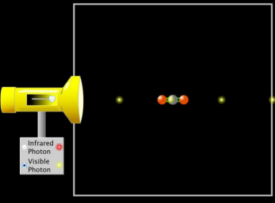
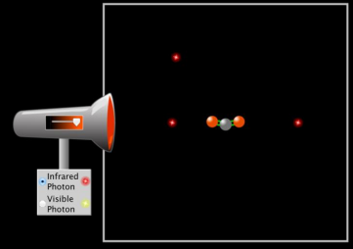
Looking Ahead: Part 3 Investigation
In Part 3, you will use a computer simulation to investigate how different kinds of energy (radiation) interact with GHG’s.

Slide 21
Key Points
Imbalances in the movement of matter and/or the flow of energy can result in disturbances to ecosystem function.
The extinction of the dinosaurs is an example; dust clouds interrupted photosynthesis, reducing carrying capacities of ecosystems, resulting in mass extinction.
Currently, there is in imbalance in the movement of carbon atoms because the release of CO₂ through fossil fuel combustion exceeds the rate of absorption of CO₂ through photosynthesis.
Greenhouse gases like CO₂ allow light to pass through but slow the loss of infrared radiation (heat energy). This is called the greenhouse effect. This helps to moderate the temperature of the earth, but excess greenhouse gases result in climate change.

Slide 22
Key Points
While CO₂ represents a relatively small proportion of the earth’s atmosphere, it is the most abundant greenhouse gas.
  More abundant gases like N₂ and O₂ are unable to interact with infrared radiation due to the molecular properties. Because CO2 has multiple elements and more than 2 atoms, it can reflect infrared radiation back to the surface of the earth.
  The greater the concentration of CO₂, the more slowly heat escapes into space.
    CO₂ levels are now at level and increasing at a pace not seen in the history of humans as a species.
Recent warming trends are unlikely to be part of a natural cycle, as the Milankovitch Cycles require 10,000-100,000 years to occur (whereas modern warming has occurred in less than 200 years).

Slide 23
Key Points
Rising CO₂ levels are causing significant ecosystem disruptions, including changing vegetation, reduced oxygen and increased acidity in aquatic ecosystems, and increases the prevalence of flooding and droughts.
  Increasing CO₂ levels also have significant ramifications for human activity. In particular, agricultural yields are significantly affected by changes in temperature and precipitation patterns.
Imbalances in other kinds of matter movement, particularly nitrogen and phosphorus cycles, are also resulting in significant ecosystem disruptions.
  Excess nitrogen and phosphorus results in eutrophication in aquatic ecosystems, causing decreases in dissolved oxygen in the water. This is resulting in massive dead zones off the coasts of North America and elsewhere.

