Slide 1
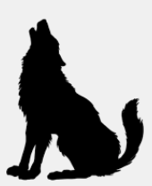
Ecosystems Unit Week 1 – How do living organisms affect each other?
Developed in part from Carbon TIME materials (carbontime.bscs.org). Used with permission.
Notes:
Image Credit: Craig Douglas, Michigan State University
Have students start to think about how cows grow.
Tell students that in today’s activity they will learn about how cows grow through digestion and biosynthesis.
Open 5.1 Tracing the Processes of Cows Growing: Digestion and Biosynthesis PPT.

Slide 2
Ecosystems Unit – W1 Driving Question
How do living organisms affect each other?
1. How do living species interact with each other and their environment?
2. What determines how many species can live in an area?
3. What happens when the movement of matter and the flow of energy through living organisms becomes disrupted?

Slide 3
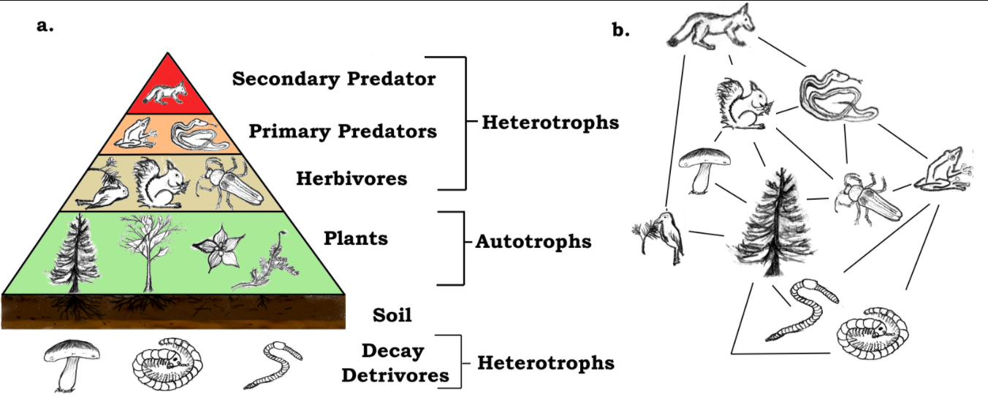
Introducing: Ecosystems!

Slide 4
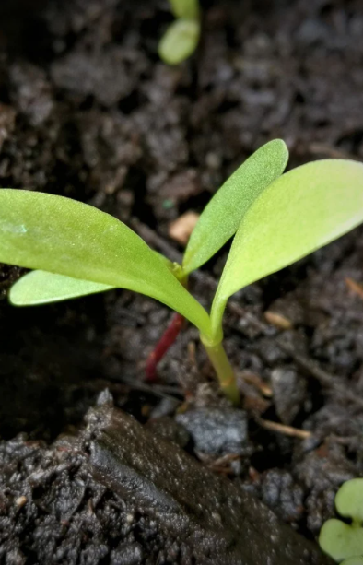
Interactions = Existence
An ecosystem consists of interactions between living species and the non-living aspects of their environment.
Species depend on photosynthetic organisms (like plants) for existence.
The atoms in all living organisms ultimately comes from glucose and soil minerals.
Plants enable all organisms to acquire the atoms needed for their biomass.
Biomass is short for biological mass, or the total amount of atoms in the molecules of living organisms.

Slide 5
Ecosystems = Interactions
Plants depend on carbon dioxide, water, soil minerals, sunlight, and other non-living components to perform photosynthesis.
Animals and decomposers provide a source of carbon dioxide and soil minerals (in their waste) needed by plants.
All species depend on interactions with other species and the non-living aspects of their environments.

Slide 6
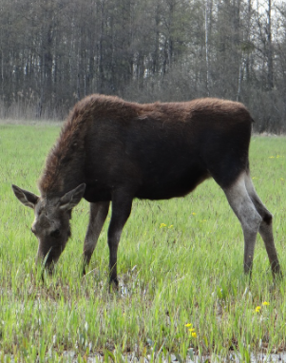
Producers & Consumers
Species in an ecosystem can be categorized as either producers or consumers.
Producers are species that are photosynthetic, such as plants, algae, and phytoplankton.
These species can produce their own food (glucose) through photosynthesis.
Consumers are species that must consume other species to acquire their food.
Animals and fungi are examples of consumers.
.
Source: Pixabay
A moose is a consumer, because it depends on producers such as grasses for the matter and energy needed by its cells.

Slide 7
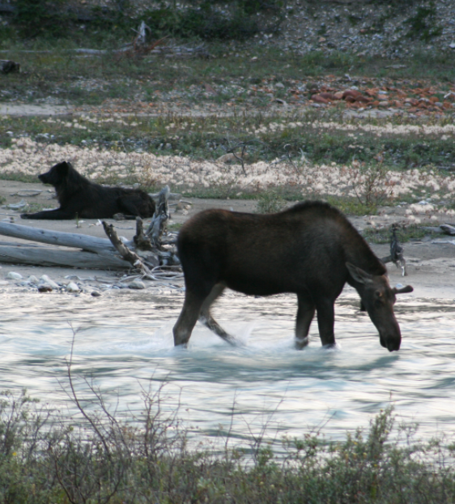
Primary & Secondary Consumers
Consumers can be classified as primary or secondary consumers.
Animals that consume plants are primary consumers.
Animals that consume other consumers are secondary consumers.
For example, the moose on Isle Royale are primary consumers, and the wolves that hunt them are secondary consumers.
A trophic level refers to whether an organism is a producer, primary consumer, or secondary consumer.
Source: Wikimedia Commons
A moose is a primary consumer, because it consumes plants. A wolf is a secondary consumer because it consumes other consumers like the moose.

Slide 8
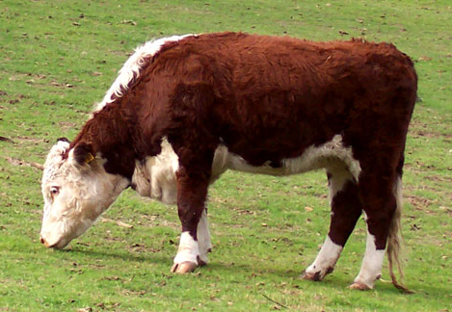
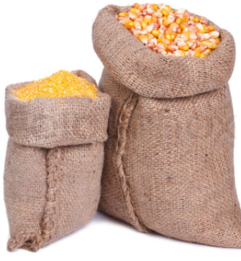
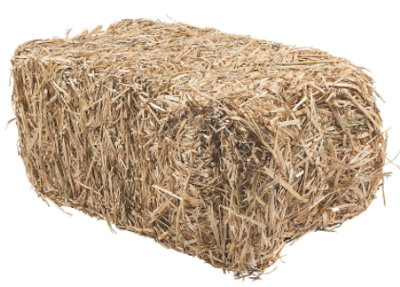
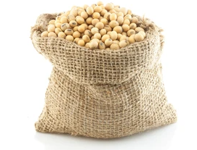
Lost Matter & Energy
Only a small percentage of the atoms in food stay in the cells of the organism that consumed it.
For every unit of biomass in a consuming organism, there has to be at least 10x as much biomass in the organisms being consumed.
For example, if a steer needs to gain 1.5 lbs. per day, they need to be fed roughly 15 lbs. of feed.
1.5 lbs. of weight gain
For a steer to gain 1.5 lbs. per day…
3.7 lbs. of corn
9.6 lbs. of hay
1.0 lbs. of soybeans
…it must consume 15 lbs. of food.
Based on this ration

Slide 9
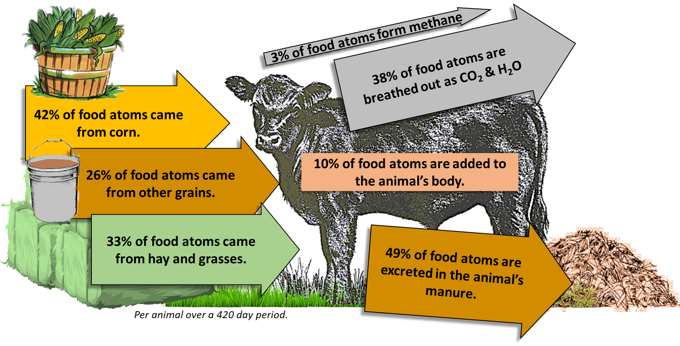
Most of the matter and energy in the food consumed by an animal is lost from the animal’s body. Most atoms from the food is lost in feces or breathed out as CO₂ and H₂O. Most of the energy is eventually lost as heat.

Slide 10
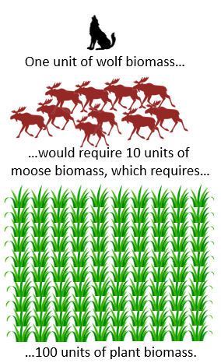
10% Rule
Only 10% of the matter and energy that an organism consumes remains in their body. This is called the 10% Rule.
The remaining 90% of atoms are lost as feces or breathed out as CO₂ & H₂O.
90% of the consumed energy in molecules is eventually lost as heat.
On Isle Royale, moose biomass must be 10x greater than wolf biomass.
Similarly, plant biomass must be 10x greater than moose biomass, and 100x greater than wolf biomass.

Slide 11
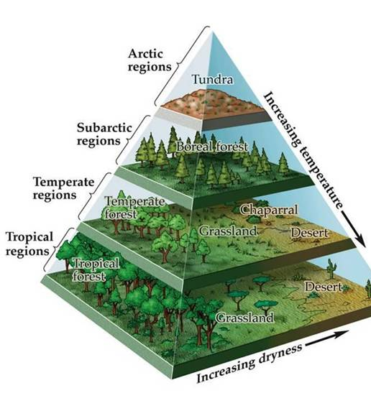
Limited Population Sizes
Small amounts of biomass = lower carrying capacity.
The 10% Rule limits the size of populations in an ecosystem.
The number of organisms is limited by the available biomass.
Greater rates of photosynthesis increases the amount of biomass of an ecosystem.
This increases the carrying capacity of an ecosystem, or the number of organisms that an ecosystem can support.
Sunnier, warmer, and wetter regions can support larger carrying capacities.
Large amounts of biomass = greater carrying capacity.
Source: http://www.hippoch.com/uploads/1/5/9/8/15988944/844906_orig.jpg

Slide 12
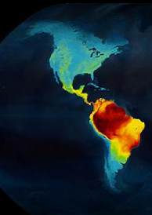
Warm/Wet vs. Cold/Dry
Ecosystems at the equator support more organisms and greater varieties of organisms due to greater rates of photosynthesis & biomass production.
The variety of living organisms in an area is known as biodiversity.
Polar regions typically have less biodiversity & lower carrying capacity.
Similarly, ecosystems at high altitudes have lower carrying capacities and less biodiversity than ecosystems at low altitudes.
This is primarily due to the differences in temperature and precipitation.
The number and variety of species per kilometer tends to be greatest near the equator due to the greater capacity for photosynthesis.

Slide 13
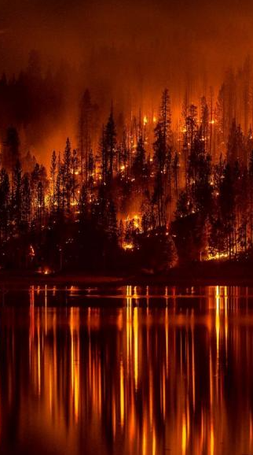
Resiliency
Resiliency refers to the capacity of an ecosystem to recover from a disturbance.
A disturbance is anything that interferes with the movement of matter and the flow of energy in an ecosystem.
The capacity for photosynthesis affects the resiliency of an ecosystem.
The greater the rates of photosynthesis, the greater the resiliency of an ecosystem.
Similarly, the greater the biodiversity, the greater the resiliency of most ecosystems.
A resilient ecosystem can recover quickly from a disturbances like wildfires.

Slide 14
Revising Our Claims
Re-visit your ideas about Isle Royale.
How do living organisms affect each other?
How do living species interact with each other and their environment?
What determines how many species can live in an area?
What happens when the movement of matter and the flow of energy through living organisms becomes disrupted?
What do you still need to know to answer this question? What is still uncertain or unknown?

Slide 15
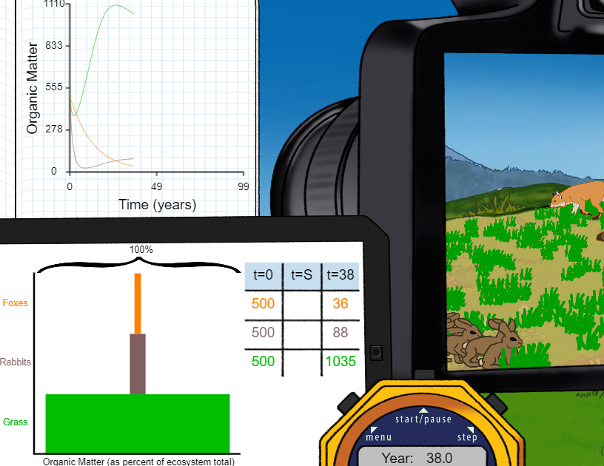
Looking Ahead: Part 3 Investigation
In Part 3, you will be conducting two investigations.
In 3A, you will compare how different sizes of populations change an ecosystem.
In 3B, you will investigate tabletop ecosystems.

Slide 16
The Big Picture: Ecosystems

Slide 17
Key Points
An ecosystem consists of interactions between living species and the non-living aspects of their environment.
Biomass is short for biological mass, or the total amount of atoms in the molecules of living organisms.
The atoms in all living organisms ultimately comes from glucose and soil minerals.
Species in an ecosystem can be categorized as either producers or consumers.
Producers are species can produce their own food (glucose) through photosynthesis
Consumers are species that must consume other species to acquire their food.
Animals that consume plants are primary consumers. Animals that consume other consumers are secondary consumers.
A trophic level refers to whether an organism is a producer, primary consumer, or secondary consumer.

Slide 18
Key Points
For every unit of biomass in a consuming organism, there has to be at least 10x as much biomass in the organisms being consumed.
For example, if a steer needs to gain 1.5 lbs. per day, they need to be fed roughly 15 lbs. of feed.
Only 10% of the matter and energy that an organism consumes remains in their body. This is called the 10% Rule.
The 10% Rule limits the size of populations in an ecosystem.
Greater rates of photosynthesis increases the amount of biomass, which increases the carrying capacity of an ecosystem, or the number of organisms that an ecosystem can support.
Sunnier, warmer, & wetter regions enable larger carrying capacities due to greater rates of photosynthesis / biomass production.

Slide 19
Key Points
Warmer ecosystems at the equator support more organisms and greater varieties of organisms due to greater rates of photosynthesis & biomass production.
The variety of living organisms in an area is known as biodiversity.
Polar regions typically have less biodiversity & lower carrying capacity due to colder, drier, darker conditions.
Resiliency refers to the capacity of an ecosystem to recover from a disturbance.
A disturbance is anything that interferes with the movement of matter and the flow of energy in an ecosystem.
The greater the rates of photosynthesis, and the greater the biodiversity, the greater the resiliency of most ecosystems.

