Slide 1
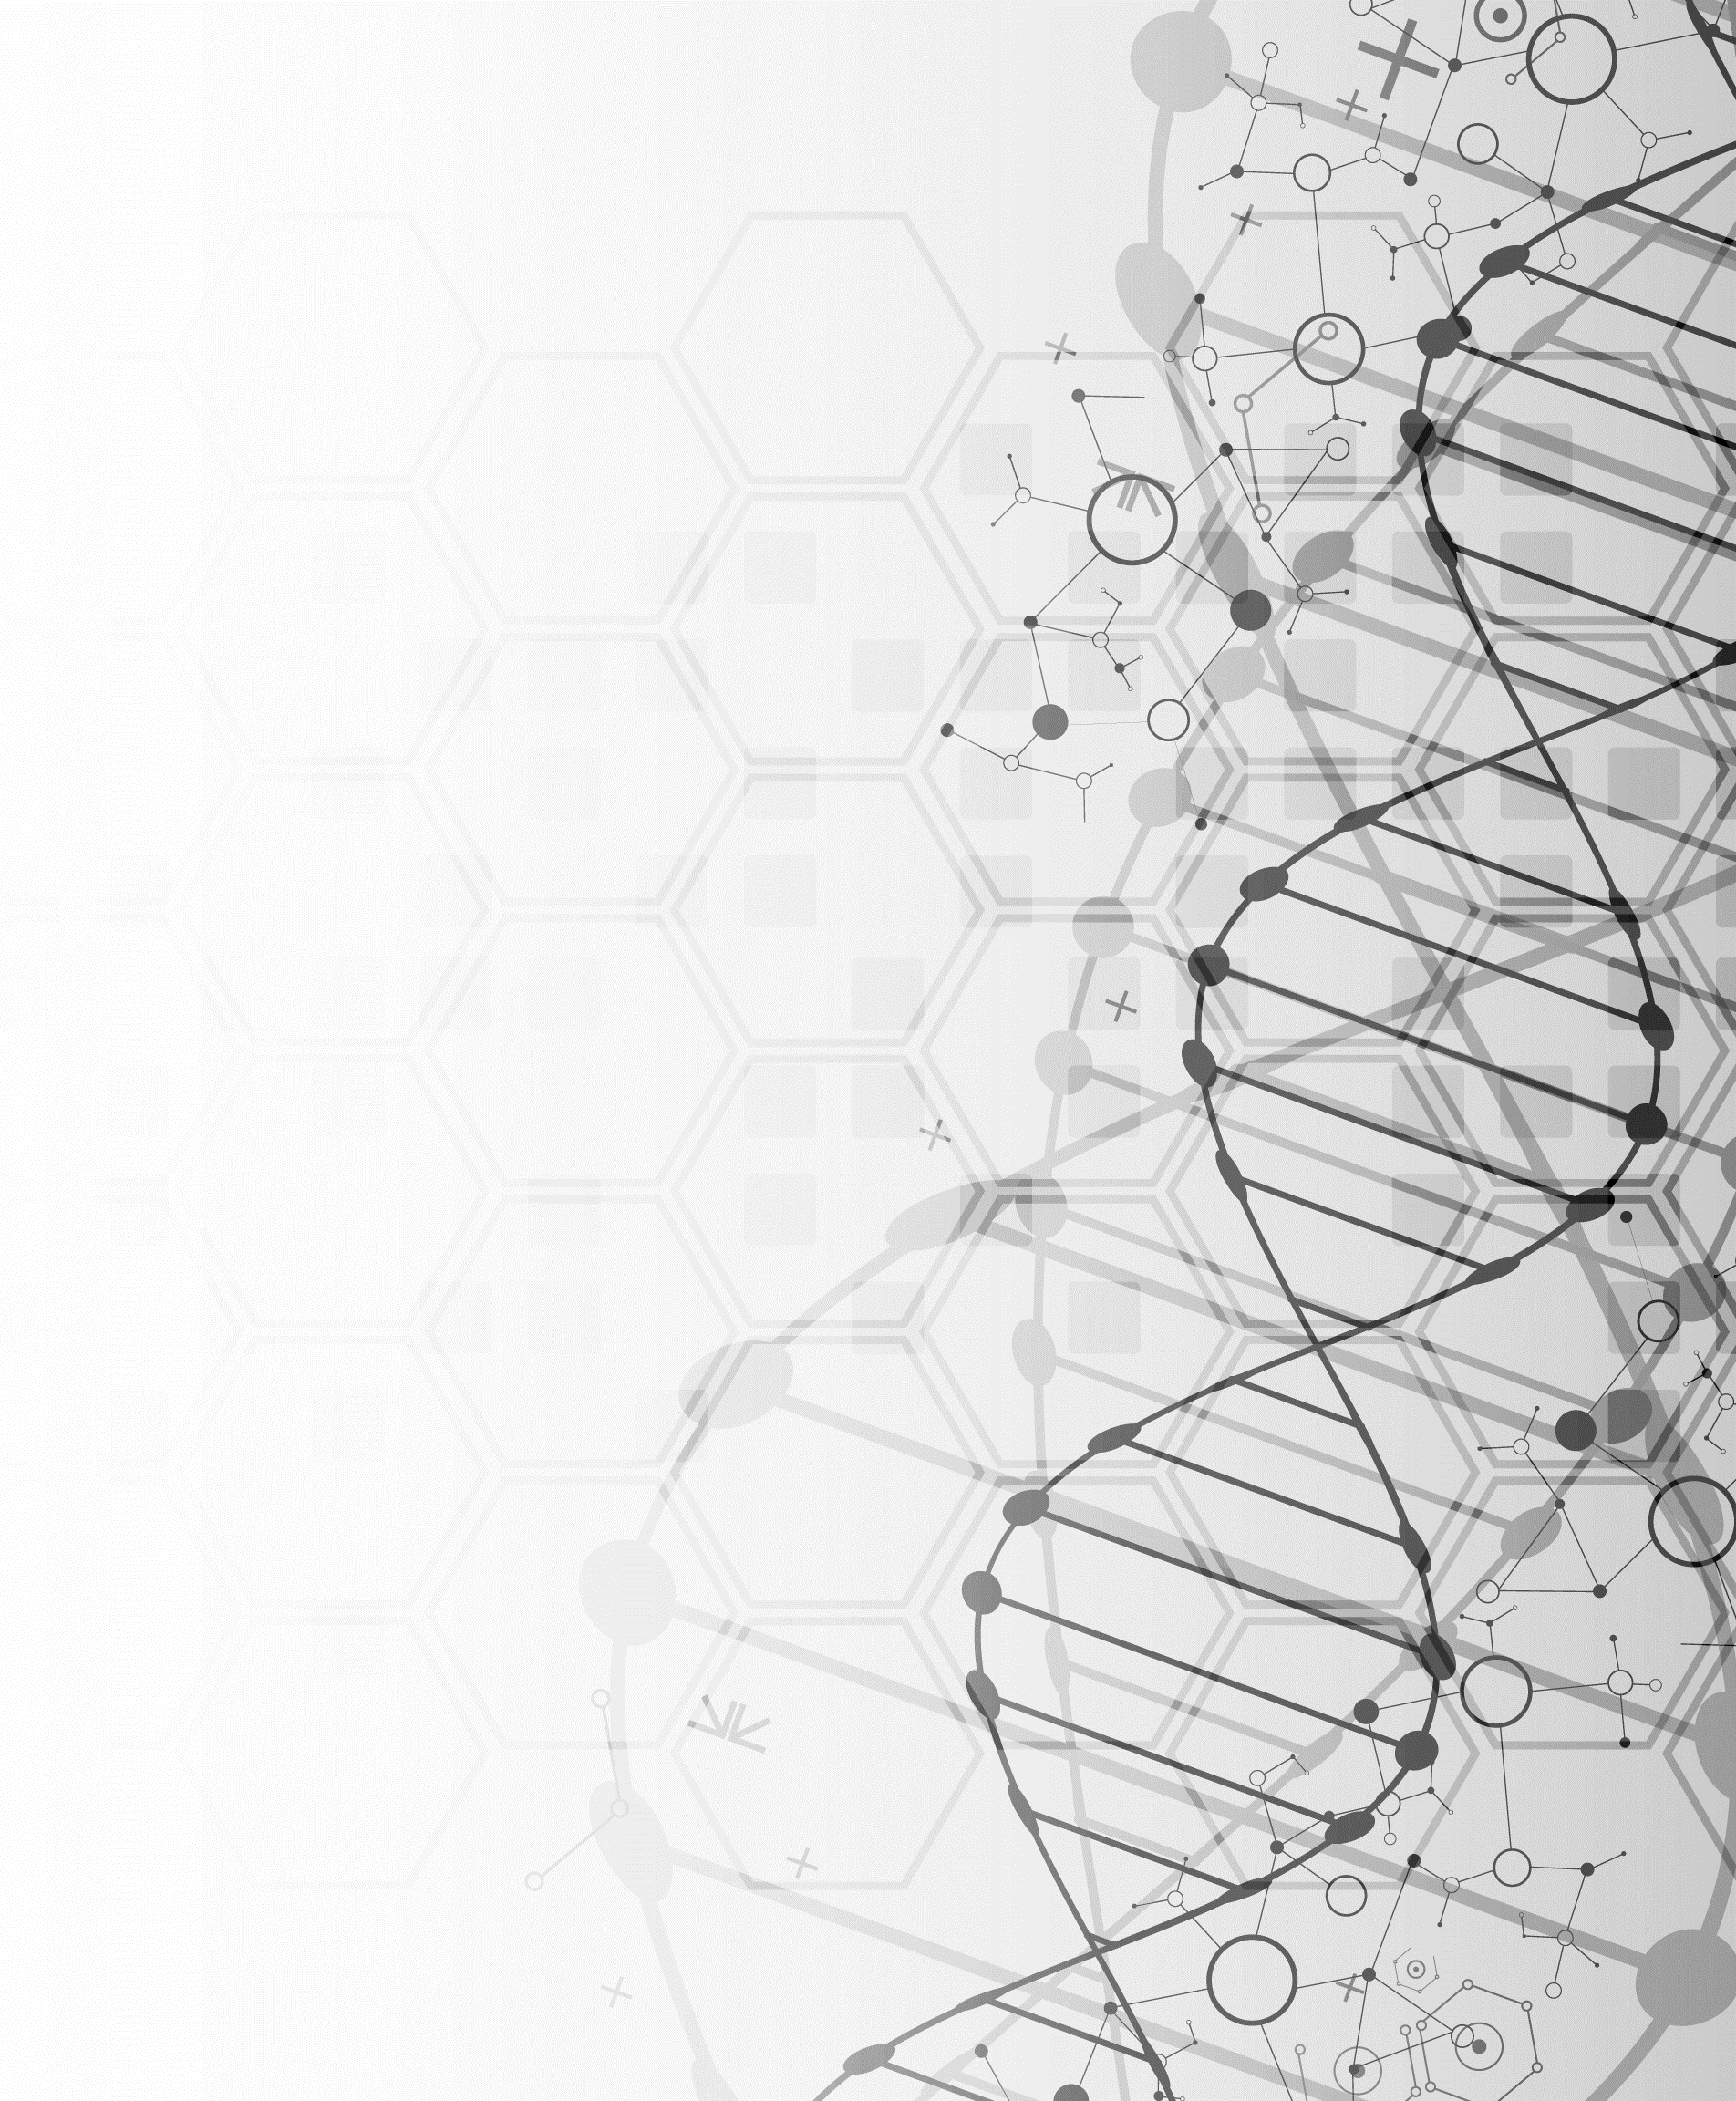
WUHS Biology: DNA & Proteins Unit
Week 1 – How are traits determined?

Slide 2
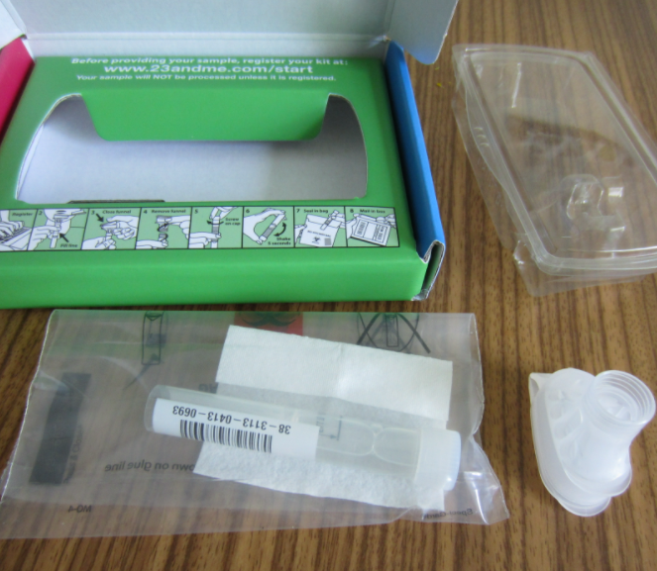
DNA & Proteins Unit – W1 Driving Question
Driving Question: What is DNA and how does it work?
What is DNA made from?
How does the structure of DNA determine its function?
How can a molecule provide instructions for the assembly of another molecule?
Image Source: Wikimedia

Slide 3
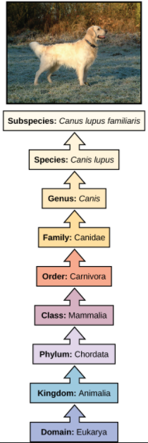
Kingdoms of Life
The world is home to a seemingly endless variety of life.
This includes multiple ‘kingdoms’ of living organisms (plants, animals, fungi, etc.), each which is divided into smaller groups.
For example, a dog is eukaryotic (its cells have organelles) and is a part of the animal kingdom.
Dogs have a spine (chordata), are mammals (warm blooded with fur), are carnivores, and are part of the dog family.
Each level of classification describes species with traits that are more and more similar.
Species are primarily classified by their observable traits.
Source: Wikimedia

Slide 4
DNA – Instructions for Life
While living species vary widely, all living organisms depend on DNA to function.
DNA enables cells to function by providing the instructions for assembling proteins.
Proteins are what primarily perform the work of the cell.
Proteins also provide organism with observable traits.
The primary function of DNA is to store information.
DNA provides the information needed to arrange amino acids in a particular order to form specific proteins.
Without DNA, a cell would lack the information needed to produce the proteins needed for cells to function.
Image Source: Wikimedia

Slide 5
DNA → RNA → Proteins → Traits

Slide 6
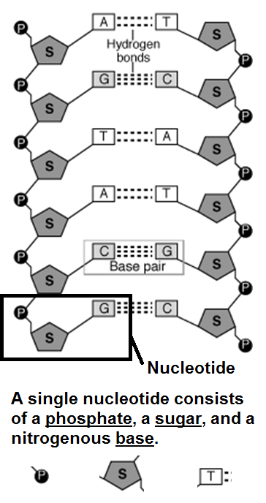
DNA is a Macromolecule
Source: www.biologyjunction.com
DNA is a macromolecule (or polymer).
DNA is composed of a long double chain of repeating monomers called nucleotides.
Each nucleotide consists of 3 parts.
1) a phosphate molecule.
2) a 5-carbon sugar molecule.
3) a base molecule.
Each nucleotide component provides a specific function.
The phosphate and the sugar are what provide the structure of the macromolecule.
The bases contain the information needed for assembling proteins from amino acids.
Four different kinds of bases exist in DNA.
Image Source: Wikimedia

Slide 7
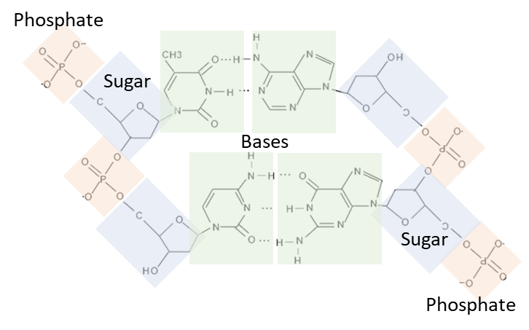
DNA Notebook Analogy
Image Source: PxHere
← Spiral
Pages
The molecules that comprise a nucleotide have functions like the components of a spiral notebook.
The phosphate molecules are like the spiral. They are on the outside and hold everything together.
The sugar molecules are like the paper pages. They hold the information in place.
The base molecules are like the writing. The bases are what provide the actual information.
The combination of different base molecules of DNA are like the words written in a notebook.
There are four kinds of base molecules.
Different combinations of bases/letters enable different kinds of information to be recorded.
Writing
Image Source: Flickr

Slide 8
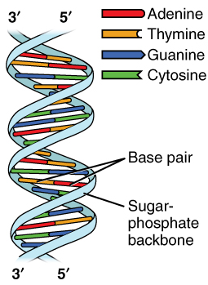
Complementary Base Pairs
There are four kinds of bases that can be found in DNA: Adenine (A), Thymine (T), Guanine (G), and Cytosine (C).
In DNA, only two combinations are possible among the four bases: A can only bond with T, and G can only bond with C.
This is due to differences in size and available bonding sites.
These combinations are called complementary base pairs.
A is complementary to T; A’s are always found with T’s.
G is complementary to C; G’s are always found with C’s.
Image Source: Wikimedia

Slide 9
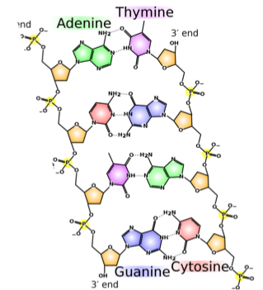
Great Combinations are Always Together
Because of both size and chemical bonding, A is always bonded to T and C is always bonded to G.
If an A were bonded to a G, they would be too large to fit inside the width of DNA.
If C were bonded to T, it would be too small to reach the sides of the DNA molecule.
This is also why bases can’t pair with themselves.
In addition, C and G have three bonding sites to attach to each other, while A and T only have two bonding sites.
Pairing an A with a C would be like trying to insert a three-pronged electrical plug into a two- pronged outlet.
Source: Wikimedia

Slide 10
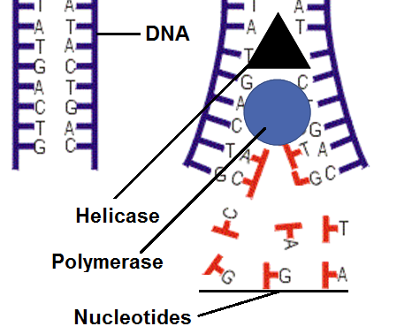
Making Copies
Source: biology.stackexchange.com
Because A is always bonded with T, and because a C is always with a G, this makes it easy for a cell to make a copy of its DNA.
To replicate DNA, a cell uses a protein called helicase to separate double-stranded DNA into two single stands.
A different protein called polymerase then adds complementary bases to the other side of each strand.
This creates two identical strands of DNA.
For example, if a section of single stranded DNA was A - G - C - T, the polymerase enzyme would add T - C - G - A to fill in the other side.
There are many free-floating nucleotide bases surrounding DNA and polymerase.
These are added by polymerase to DNA when making a copy.

Slide 11
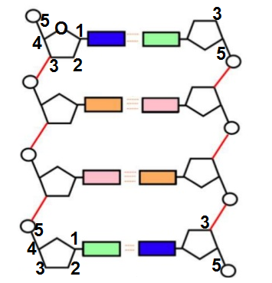
There is no top, bottom, left, or right inside of a cell.
As such, polymerase proteins need a way to determine what direction to start copying DNA.
DNA is replicated in a 5’ → 3’ direction.
5’ and 3’ refer to the carbon atoms on the sugar molecule.
The direction DNA is copied on one side will be opposite of the direction in which it is copied on the other side.
If the left side is copied from the top down, the right side will be copied from the bottom up.

Slide 12
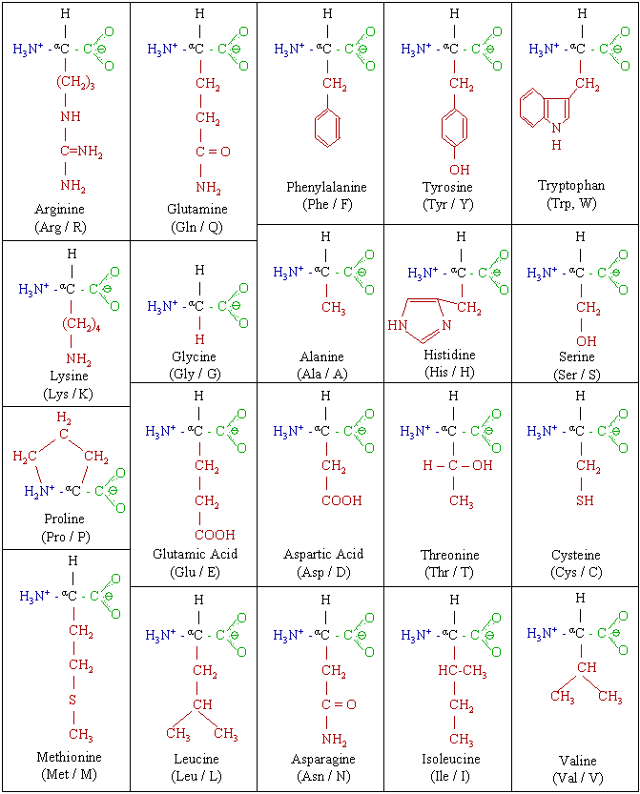
The DNA “Code”
DNA provides the instructions for how to assemble 20 amino acids in a specific order to create a particular protein.
The order in which 20 different kinds of amino acids are assembled determines the shape and function of the protein.
Combinations of three bases (called codons) code for a specific amino acid.
For example, a stretch of DNA containing 9 bases would consist of 3 codons.
These 3 codons would each code for 3 kinds of amino acids.
The order of codons in a gene determines the order in which amino acids are assembled to form a protein.
There are 20 kinds of amino acids. Different combinations of amino acids make different proteins.

Slide 13
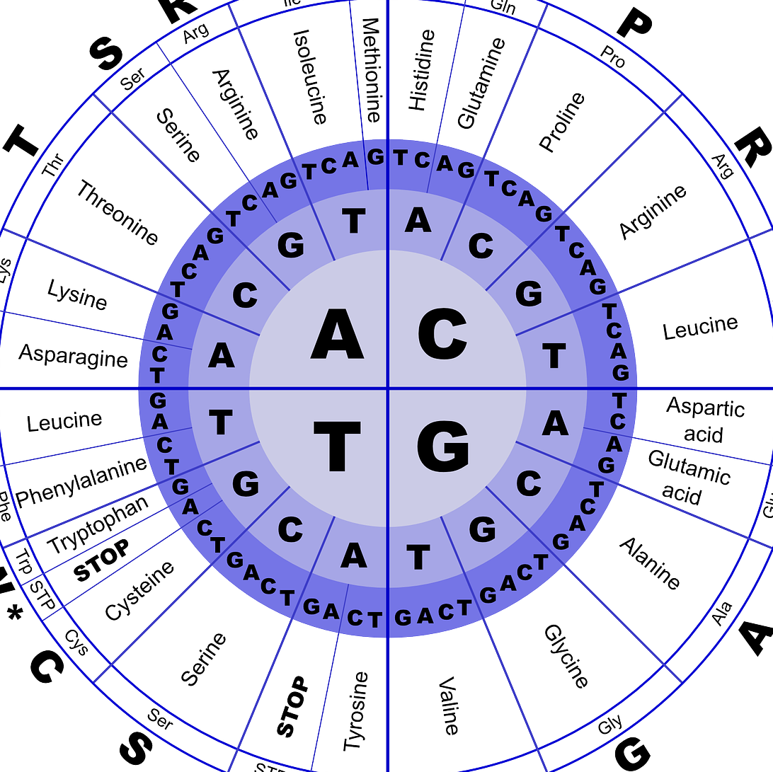
Decoding Codons
Image Source: Pixabay
Each combination of three bases (codon) codes for a different amino acid.
For example, CGA codes for Arginine.
However, AGC codes for Serine.
Some codons indicate where a gene begins and ends.
All genes start with the Methionine amino acid (ATG).
Three different codons (TGA, TAG, and TAA) mark the end of a gene.
This table can be used to translate codons into different amino acids. Start in the center and work towards the outside. E.g., GCA = Alanine.

Slide 14
Revising Our Claims
Revisit your ideas from Part 1.
How could you improve your responses to our Driving Questions?
What is DNA and how does it work?
What is DNA made from?
How does the structure of DNA determine its function?
How can a molecule provide instructions for the assembly of another molecule?
Image Source: Wikimedia

Slide 15
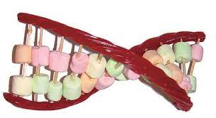
Looking Ahead: Part 3 Investigation
In Part 3 you will be conducting two investigations.
In Part A, you will use your understanding of DNA to determine how nucleotide components fit together.
In Part B, you perform a similar investigation using different kinds of candies to create edible DNA.
Image Source: Michigan.gov

Slide 16
Key Points
Species are primarily classified by their traits, which are determined by the proteins their cells produce, which is determined by their DNA.
The primary function of DNA in all living organisms is to store information for how to assemble proteins.
DNA is a polymer made of nucleotide monomers. Each nucleotide has 3 parts: a phosphate, a sugar, and one of four bases.
Phosphate and sugar molecules provide structure to DNA; the base molecules are what code information for assembling proteins.

Slide 17
Key Points
Due to differences in size and bonding sites, only two combinations are possible among the four bases: A only bonds with T, and G only bonds with C. This is called complementary base pairs.
To replicate DNA, a protein called helicase separates the two strands. A protein called polymerase then adds complementary bases to each strand to create two identical strands.
DNA is always copied in a 5’ → 3’ direction. These numbers refer to the carbon atoms on the sugar molecule.
Groups of 3 bases (called codons) code for specific amino acids. The order of codons in a gene determines the order of amino acids in a protein. This determines the kind of protein that is assembled.

Slide 18
Key Vocab
DNA: a polymer made from nucleotide monomers that stores information about how to assemble proteins.
Nucleotide: a monomer in the DNA polymer consisting of a phosphate, sugar, and base molecule.
Phosphate: a part of a nucleotide that provides structure to DNA.
Sugar: a part of a nucleotide that holds bases in place.
Base: a part of a nucleotide that stores information.
Complementary Base Pairs: the only combinations of bases that are possible in DNA (A pairs with T; G pairs with C).
Helicase: the protein that separates the two DNA strands.
Polymerase: the protein that makes copies of DNA.
Codon: a group of three bases in DNA that codes for a specific amino acid.

Slide 19
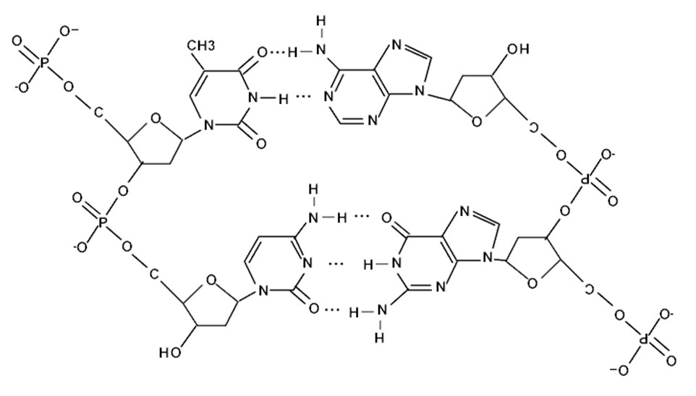
Phosphate
Sugar
Bases
Sugar
Phosphate

