Slide 1
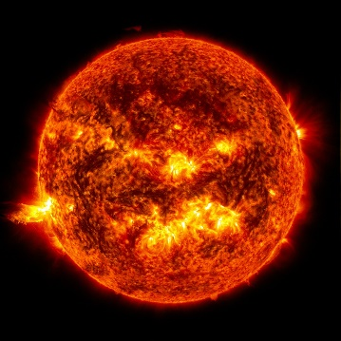
How the Sun Works Unit Week 2 – What’s inside the sun?
Developed from Carbon TIME materials (carbontime.bscs.org). Used with permission.
Notes:
Image Credit: Craig Douglas, Michigan State University
Have students start to think about how cows grow.
Tell students that in today’s activity they will learn about how cows grow through digestion and biosynthesis.
Open 5.1 Tracing the Processes of Cows Growing: Digestion and Biosynthesis PPT.

Slide 2
Sun Unit – W2 Driving Question
This week’s driving question: What’s inside the sun?
How can we measure what is in the sun if we can’t visit the sun?
What is sunlight?
Can the structure of the sun tell us anything about its function?

Slide 3
Studying the Sun
The sun is too far away and too intense to study directly.
However, the earth is bombarded by light and other forms of radiation from the sun.
Most of our understanding of the sun as well as the rest of the universe emerged from the analysis of this radiation.

Slide 4
Radiation
Radiation is emitted energy (or energy that moves) .
Most often, the radiation we experience is electromagnetic radiation (or gamma radiation), which consists of moving waves of energy.
Examples include light (photons), as well as X-rays and microwaves.
The size of the wavelength determines the type of the EM radiation (e.g., radio waves have the shortest wavelengths; x-rays are among the longest).
Radiation can also exist as moving subatomic particles.
Alpha radiation entails positively charged protons and neutrons
Beta radiation consists of negatively charged high-energy electrons.

Slide 5
Spectroscopy
Spectroscopy is the study of diffracted light.
Diffraction is the ‘bending’ of light around an object.
For example, Isaac Newton was the first to demonstrate that when white light passes through a prism, it is dispersed into a full color spectrum.

Slide 6
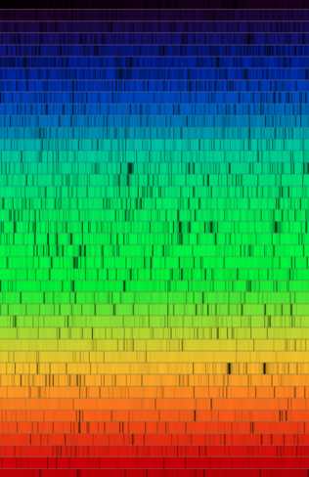
“Gaps” in the light
As scientists began to develop more accurate and precise prisms, they noticed “gaps” in the light.
Instead of uniform bands of light, dark bands sometimes appeared between colors (the spectral signature).
When light moves through clear containers of different gases, each gas has a unique banding pattern.

Slide 7
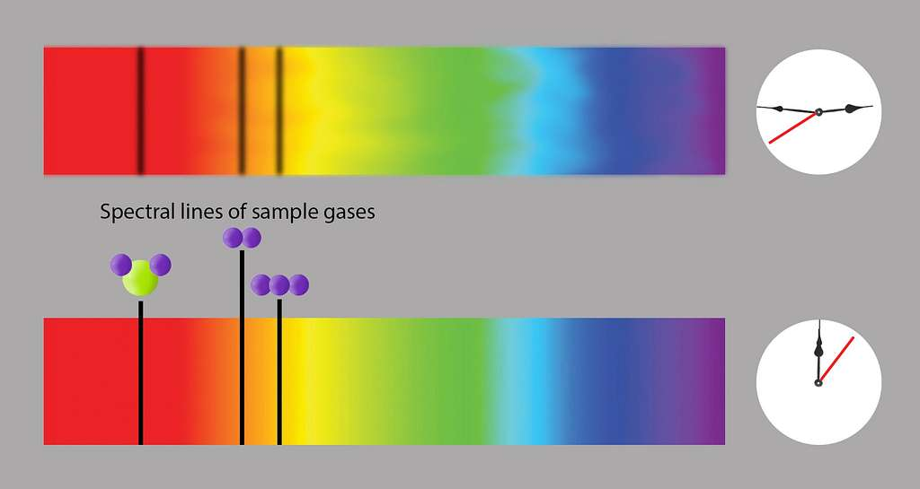
Spectral Signatures
Scientists soon realized that each gas had a particular pattern of “gaps” associated with it.
When light passed through a gas, it “lost” light in predictable places that were specific to each kind of gas.

Slide 8
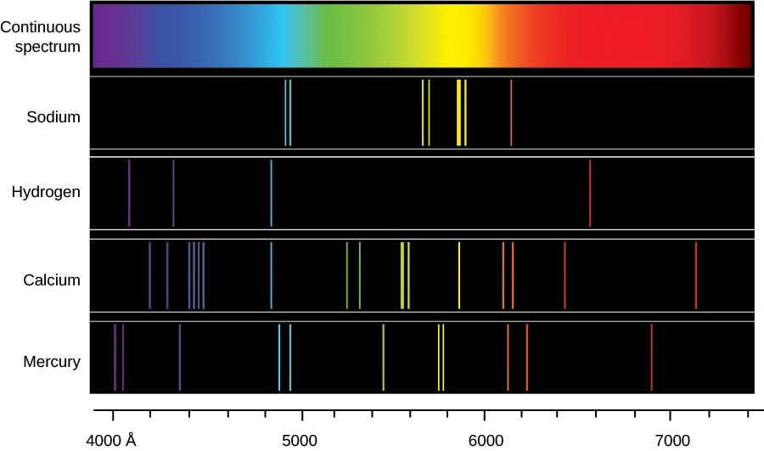
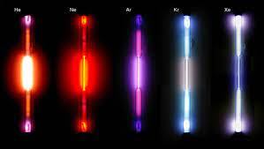
Glowing Gases
Similarly, scientists observed that if gases were heated, they “glowed” with particular colors.
These were the same colors that were missing from the gaps when light was shown through the gases.
Heated gases only emitted light at certain specific wavelengths of light (i.e., in specific colors).
Source: https://courses.lumenlearning.com/astronomy/chapter/spectroscopy-in-astronomy/

Slide 9
Absorption vs. Emission Lines
If light passes through a gas (such as hydrogen, shown below), it is absorbed at specific wavelengths.
This can be observed as absorption lines, or ‘gaps’ in light.
If a gas is heated, it only releases light in specific wavelengths.
These appear as emission lines or individual bands of light at specific wavelengths.
The gaps in absorption lines match up with the wavelengths of light produced in emission lines.
Source: www.shutterstock.com

Slide 10
Spectral Signatures
Each element produces a unique spectral signature (color pattern) because of its subatomic properties.
When an electron absorbs energy (such as heat), it moves to a higher orbit around the atom’s nucleus.
When the electron moves back to a lower orbit, it releases this energy as specific wavelengths of light (photon).
Electron
-
-
Higher Orbit
Emitted Photon
-
-
Lower Orbit
Nucleus (protons & neutrons)
Heat

Slide 11
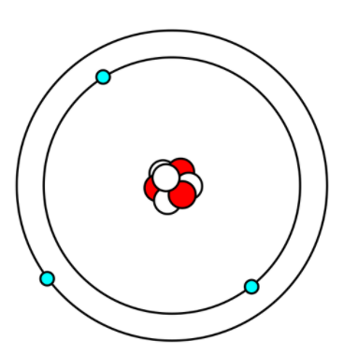
Reminder: Parts of the Atom
Protons – positively charged particles in the nucleus.
The number of protons determines the element.
Neutrons – neutral particles in the nucleus.
Electrons – negatively charged particles that orbit the nucleus.
Electrons that absorb energy can move to a higher orbital.
When electrons drop to a lower orbital, they emit energy as a photon of light.
Higher Orbit
Electron
Lower Orbit
Nucleus (protons & neutrons)

Slide 12
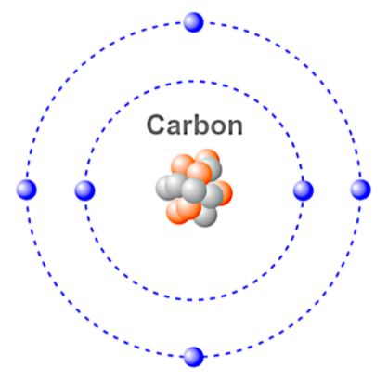
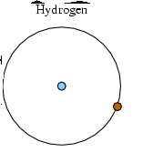
Why are there differences?
Each element has a specific number of protons in its nucleus.
To be electrically neutral, an element needs to have equal numbers of positive protons and negative neutrons.
Elements with greater numbers of protons can support more orbiting electrons, resulting in increasingly complex spectra.
For example, a hydrogen atom only has one proton and one neutron. As a result, hydrogen has a simple spectra.
However, a carbon atom has six protons and (usually) six electrons →
This can result in a wide variety of transitions between orbital levels among these electrons.

Slide 13
Interpreting Spectral Bands
The light emitted by an object (such as a star) will create a unique spectral signature based on the elements it contains.
The banding pattern, and the intensity of each pattern indicates the atomic components of the source of light.
Spectral analysis of our solar system’s sun indicates that it is roughly 70% hydrogen, 28% helium, and 2% carbon, nitrogen, oxygen, and other trace elements.

Slide 14
Revisions to W2 Driving Question
Can we now improve our answers to our driving questions?
What’s inside the sun?
How can we measure what is in the sun if we can’t visit the sun?
What is sunlight?
Can the structure of the sun tell us anything about its function?

