Slide 1
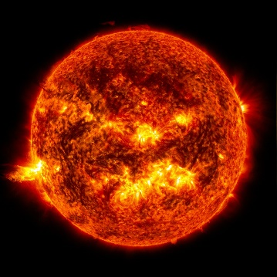
How the Sun Works Unit Week 4 – Where does the sun’s energy come from?
Notes:
Image Credit: Craig Douglas, Michigan State University
Have students start to think about how cows grow.
Tell students that in today’s activity they will learn about how cows grow through digestion and biosynthesis.
Open 5.1 Tracing the Processes of Cows Growing: Digestion and Biosynthesis PPT.

Slide 2
Sun Unit – W3 Driving Question
This week’s driving question: Where does the sun’s energy come from?

Slide 3
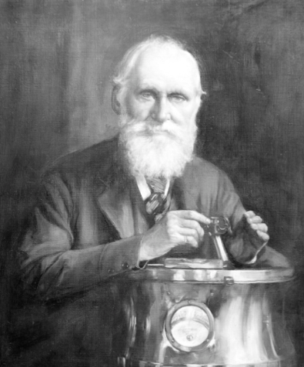
Week 2 Recap
We now know that the sun is primarily composed of hydrogen and helium.
We also know the size, distance, and temperature of the sun.
We now have the info we need to answer our original question – How can the Sun burn continuously for more than a few tens of millions of years at most without exhausting its fuel?
Lord Kelvin is still waiting for an explanation…

Slide 4
The Big Ideas
If you know the mass and surface temperature of the sun, you can determine the temperature inside the sun.
This determination is based on the relationship between pressure and temperature in gases.
If you know the temperature inside the star and its atomic composition, you can begin to determine how the sun is able to ‘burn’ continuously for billions of years.
Notes:
The mass of the sun is known precisely from the way it’s gravity influences the orbits of the planets

Slide 5
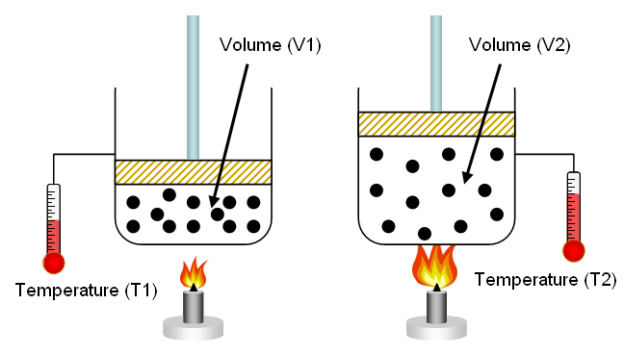
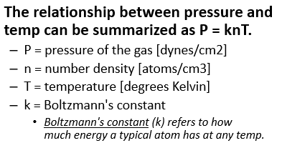
Gas Laws
When you heat a gas, the pressure increases.
Hotter temps increase the speed at which particles move.
This increase the rate and force at which particles collide, generating more heat.
Similarly, if you increase pressure, a gas heats up as particles collide more frequently.
Image Source: https://www.chem.fsu.edu/chemlab/chm1045/gas_laws.html
Notes:
Real-life example – if you have ever used a can of compressed air, you might notice that it feels cool to the touch after use. This is because the pressure was reduced, causing the temperature within the can to be reduced.

Slide 6
Subatomic Components
-
Neutron
-
Electron
+
Proton
Reminder: atoms consist of three components: electrons, protons, and neutrons.
Electrons are negatively charged, orbiting the nucleus of the atom.
The nucleus consists of positively charged protons and uncharged neutrons.
The number of protons determines the type of element (e.g., hydrogen atoms have one proton; helium atoms have two protons).

Slide 7
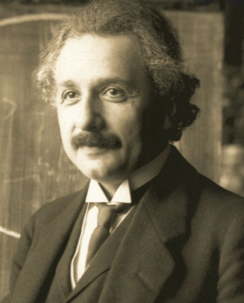
Origins of Understanding
Our understanding of the function of the sun emerged in part from Einstein’s most famous work in 1905 - E = mc².
This equation indicates that the amount of energy in a substance is equal to its mass (m) multiplied by the speed of light squared.
This alludes to the notion that energy and matter are interchangeable.
In other words, matter and energy are different forms of the same thing.
Because the speed of light is an enormous number (300,000 km/sec or 186,000 miles/sec), even tiny amounts of matter contain large quantities of energy.
Why the speed of light?
If something is converted into pure energy, it would have to be moving at the speed of light, as all electromagnetic radiation travels at a constant speed.
Notes:
More details at https://www.pbs.org/wgbh/nova/einstein/lrk-hand-emc2expl.html

Slide 8
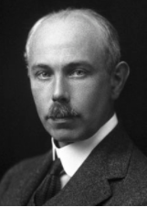
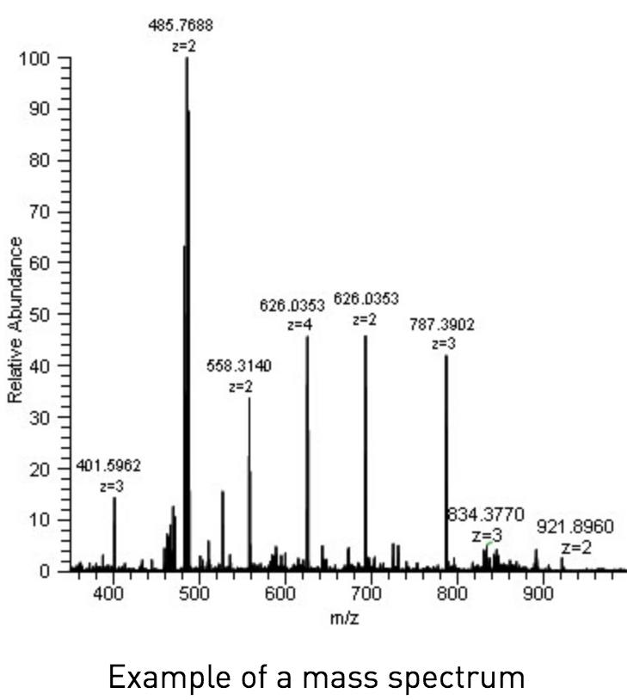
Origins of Understanding
In the 1920s, F. W. Aston developed a method for calculating the exact molecular weight of elements.
Aston’s work led to the development of mass spectrometry.
This analytical tool converts substances into gases.
The individual components are then separated by relative electrical charge using electromagnetic fields.
The gases are then passed through a tiny needle according to their mass-to-charge (m/z) ratios.
Notes:
https://www.broadinstitute.org/technology-areas/what-mass-spectrometry

Slide 9
Mass Spectrometer
By converting a substance into an ionized gas and separating it by its mass-to-charge (m/z) ratio, researchers can determine the mass at the atomic and subatomic level.

Slide 10
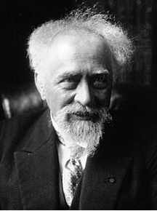
Origins of Understanding
In conducting his work, Aston inadvertently determined that four hydrogen nuclei were heavier than a helium nucleus.
Around the same time, Jean Perrin independently suggested that that the fusion of hydrogen into helium was the energy source of the Sun and other stars.
Perrin’s ideas provided a potential explanation for the ‘missing mass’ observed by Aston.
I.e., some of the mass of hydrogen atoms might be converted into energy if fused.
Image Source: https://www.physicsoftheuniverse.com/how-does-the-sun-shine.html?scrlybrkr=b3fbf18e
Notes:
More details at https://www.pbs.org/wgbh/nova/einstein/lrk-hand-emc2expl.html

Slide 11
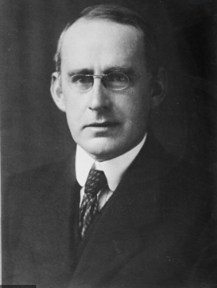
Eddington’s Realizations
Arthur Eddington first recognized the implications of the collective findings of Einstein, Aston, and Perrin.
Einstein proposed that matter could be converted into energy (which Eddington confirmed by measuring the ‘bending’ of light during an eclipse due to gravity).
Perrin proposed that hydrogen fusion into helium powered the sun.
Aston observed that fused hydrogen (i.e., helium) was lighter than the hydrogen atoms by themselves.
Eddington provided the first evidence-based argument that the "vast reservoir of energy” in the sun was “subatomic energy which, it is known, exists abundantly in all matter…”
Notes:
Eddington’s original remarks can be found at - http://articles.adsabs.harvard.edu/cgi-bin/nph-iarticle_query?bibcode=1920Obs....43..341E&db_key=AST&page_ind=0&data_type=GIF&type=SCREEN_VIEW&classic=YES

Slide 12
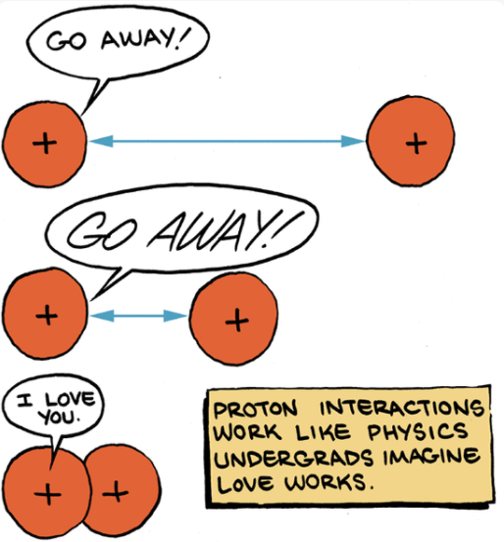
Gas Laws
In most cases, the nuclei of atoms cannot interact.
This is due to the Coulomb barrier – two positively charged nuclei will repel each other.
Large amounts of energy (in the forms of heat and motion) are needed to overcome this barrier and allow the nuclei to interact.
Under extremely high temps and pressure, electrons are stripped from their atoms.
Under these conditions (which exist within all stars), protons can merge or fuse (hence the term, nuclear fusion).
Image Source: https://www.physicsforums.com/threads/what-is-an-electrostatic-coulomb-barrier-how-is-it-created.921720/

Slide 13
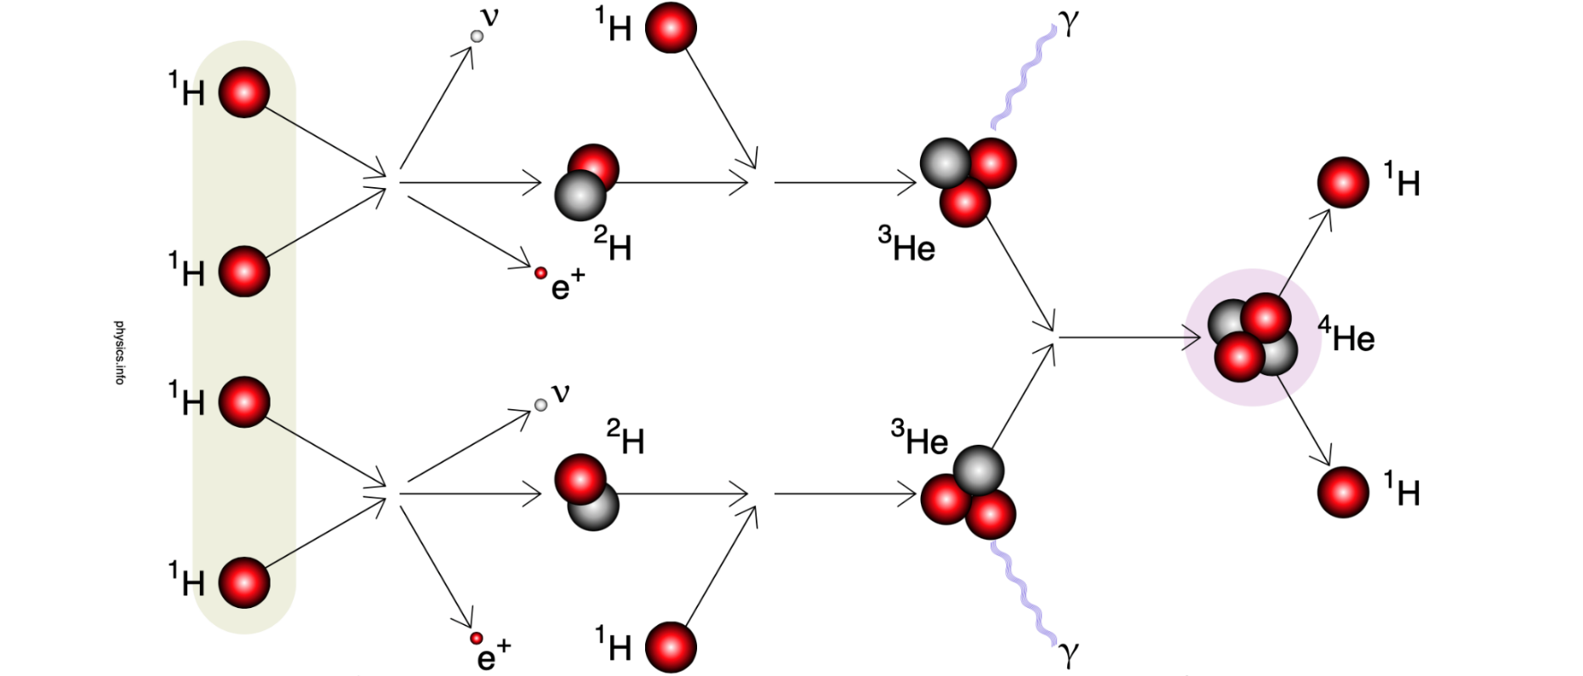
Hydrogen Fusion
We now know that the sun’s energy output is primarily due to the fusion of hydrogen into helium.
Specifically, four hydrogen protons are fused to form a helium nucleus in a process called proton-proton chain.
In this process, 0.7% of the mass of hydrogen is converted into heat energy and neutrinos (an uncharged particle that mostly does not interact with matter).
Image Source: https://physics.info/fusion/
Notes:
https://content-calpoly-edu.s3.amazonaws.com/evolution/1/images/3universe/stardust/nuclearWikis/Stellar_nucleosynthesis%20-%20wiki.pdf

Slide 14
Proton-Proton Chain
1. Two hydrogen protons (¹H) fuse, making deuterium (²H, a proton & neutron). Because a proton becomes a neutron, a positive electron (or positron, e⁺) and a neutrino are ejected.
2. The deuterium (²H) captures another ¹H proton to form Helium-3 (³He). Radiation is emitted as gamma rays (γ).
3. Two Helium 3 (³He) fuse to form one helium-4 (⁴He) nucleus. They eject two hydrogen protons (¹H).
Image Source: https://physics.info/fusion/

Slide 15
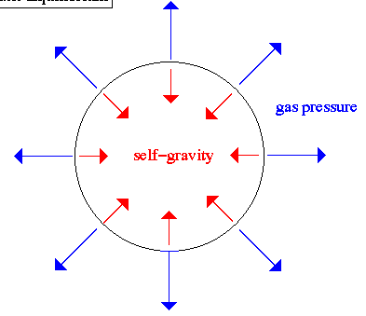
Gas Laws
A key principle that determines the structure and life of stars is hydrostatic equilibrium
In other words, the outward pressure of radiation from nuclear fusion must balance gravity`s inward pressure.
At every position in a star, the pressure of the gas must be just enough to support the ``weight'' of the star above it.
If this is not the case, the star would expand or contract and eventually become unstable.
Hydrostatic Equilibrium
Source: http://ircamera.as.arizona.edu/NatSci102/NatSci102/text/hydrostat.htm

Slide 16
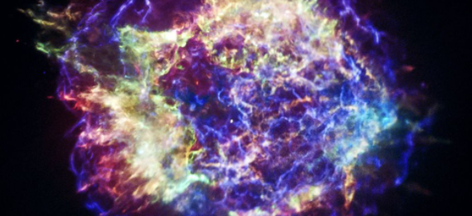
Eddington’s 3 Outcomes
Eddington determined there are only 3 possible outcomes for a ball of gas like a star:
1) If too small to create the conditions needed for fusion, it becomes a cool ball of gas (e.g., the gas planets).
This is any planet under 10³² g of gas.
2) If it is the right size to balance outward and inward pressures, it becomes a star.
This is any planet between 10³² and 10³⁵ g of gas.
3) If it is too big, it will eventually explode due to excess outward pressure from radiation.
This is any planet above 10³⁵ g of gas

Slide 17
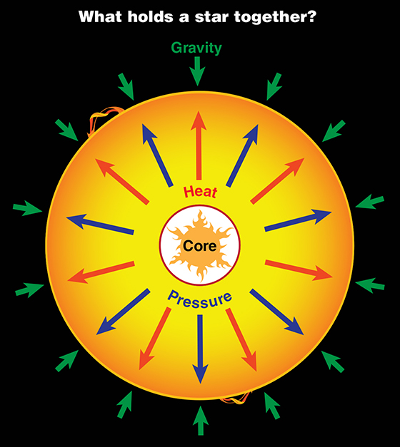
Thermal Regulation
Nuclear reactions produce outward pressure, counteracting the forces of gravity and its effects on pressure/temp.
If a star shrinks, it will get hotter, making it expand and cool, causing it to shrink.
If a star expands, it will cool, and gravitational pressure will make it contract.
While nuclear reactions are what make a star hot, they also keep a star from getting too hot.
Without these outward pressures, the star would contract, raising the temperature due to the relationship between temperature & pressure.
Source: https://iopscience.iop.org/book/978-1-64327-422-5/chapter/bk978-1-64327-422-5ch5

Slide 18
Revisions to W3 Driving Question
Can we now improve our answers to our driving questions?
Where does the sun’s energy come from?

