Slide 1
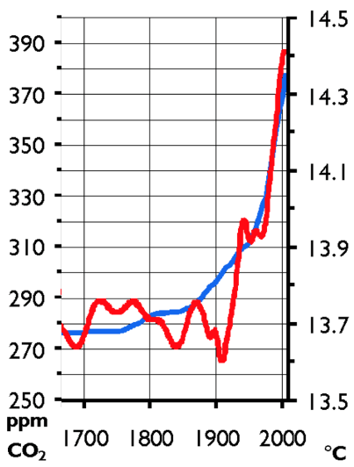


Ecosystems Unit
Week 2 – How do imbalances cause ecosystem disturbances?
Developed in part from Carbon TIME materials (carbontime.bscs.org). Used with permission.
Notes:
Image Credit: Craig Douglas, Michigan State University
Have students start to think about how cows grow.
Tell students that in today’s activity they will learn about how cows grow through digestion and biosynthesis.
Open 5.1 Tracing the Processes of Cows Growing: Digestion and Biosynthesis PPT.

Slide 2

Ecosystems Unit – W2 Driving Question
How do imbalances in matter and energy cause ecosystem disturbances?
How do ecosystems enable matter movement and energy transformation?
How do imbalances in matter and energy occur?
What happens when matter and energy are unbalanced?
How does human activity relate to these kinds of disturbances?

Slide 3
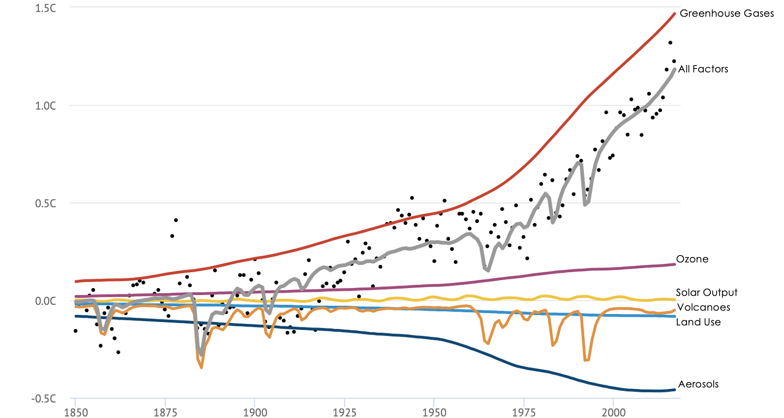
Part 1 Recap
Earlier we investigated how carbon dioxide and temperature are related.
We determined that there is a correlation between levels of CO₂ and changes in temperature.
We also observed that increases in average temperatures correlate with increases in carbon dioxide since the Industrial Revolution.

Slide 4
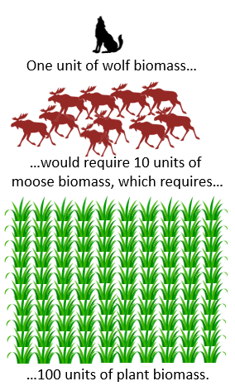
Recap of Week 1
Ecosystems are the interactions between organisms and the non-living aspects of their environment.
Rates of photosynthesis and the 10% Rule → determine the carrying capacities of ecosystems.
  Warmer, wetter, sunnier environments can support greater rates of photosynthesis.
  More plant biomass production supports greater carrying capacities (numbers of species a habitat can support) and more biodiversity (variety of living species).
A disturbance is anything that interferes with the movement of matter and the flow of energy.
  Habitats with greater rates of photosynthesis have more resiliency to disturbances.

Slide 5
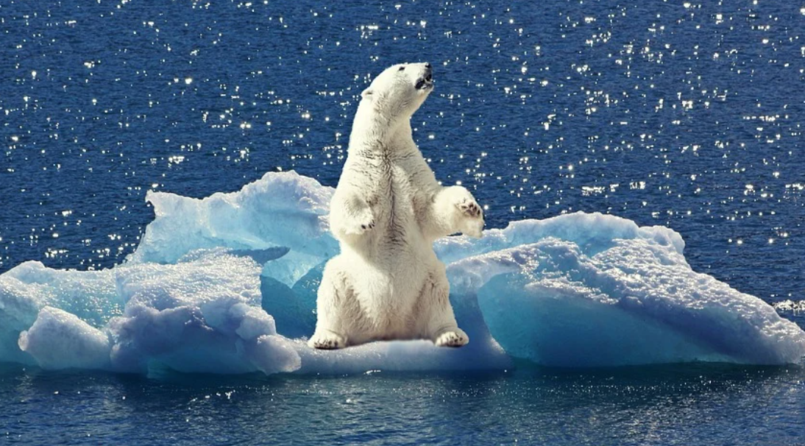
Matter & Energy Imbalances and ecosystem Disturbances
Image Source: Pixabay

Slide 6
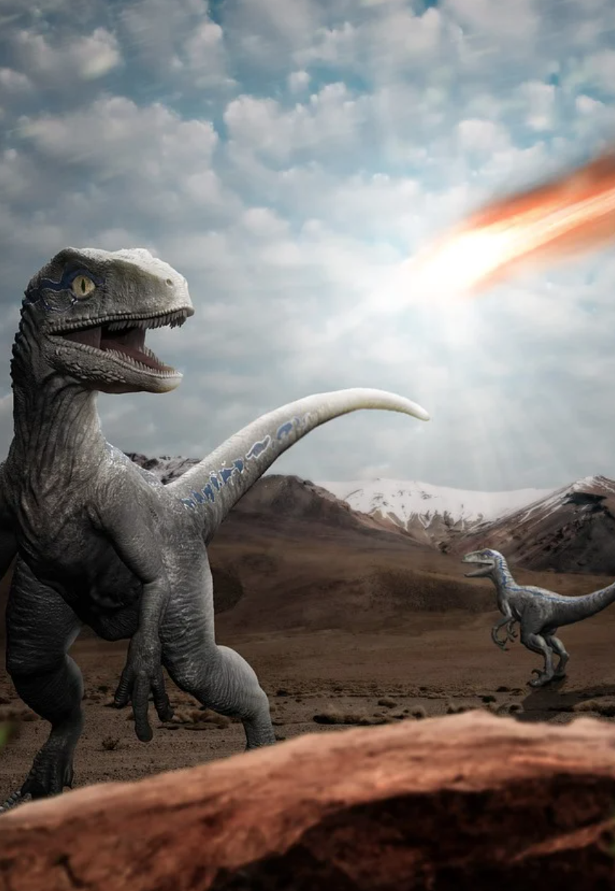
Imbalances = Disturbances
Disturbances reduce the carrying capacity of ecosystems by disrupting the matter movement and energy transformation.
  For example, 65 million years ago an asteroid hit earth.
  Dust moved into the atmosphere, reducing rates of photosynthesis.
  This lowered ecosystem carrying capacities, resulting in the extinction of the dinosaurs and other species.
Image Source: Pixabay
Notes:
Note: this is not necessarily a settled science, and significant debate is still occurring as to the rate at which the dinosaurs went extinct. Example news articles: https://news.yale.edu/2011/07/12/last-dinosaur-mass-extinction-discovered

Slide 7
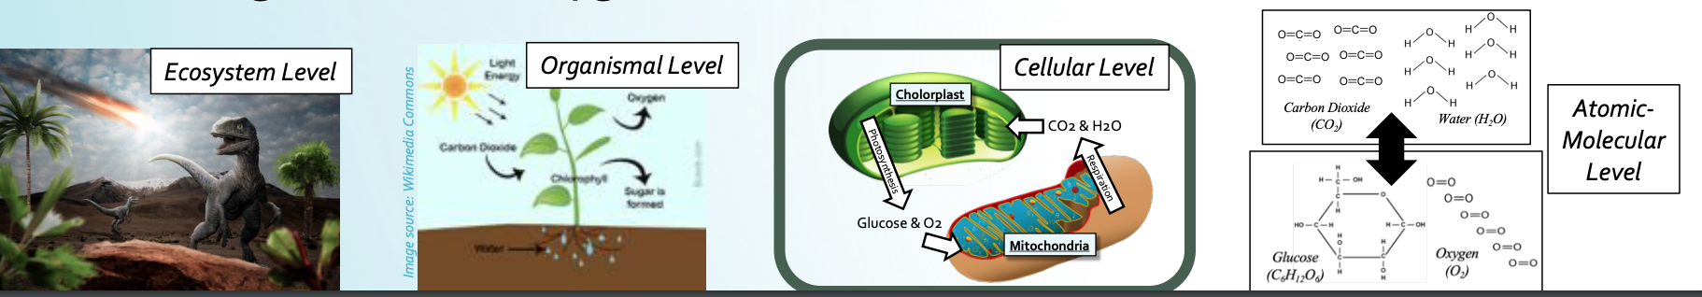
Changes Across 4 Levels
The effects of an asteroid caused changes at four levels.
  Dust from the asteroid strike limited sunlight that reached ecosystems (ecosystem level).
  This limited plant function (organismal level) by reducing photosynthesis (cellular level).
  This reduced the production of glucose and O₂ from CO₂ and H₂O molecules (atomic-molecular level).

Slide 8
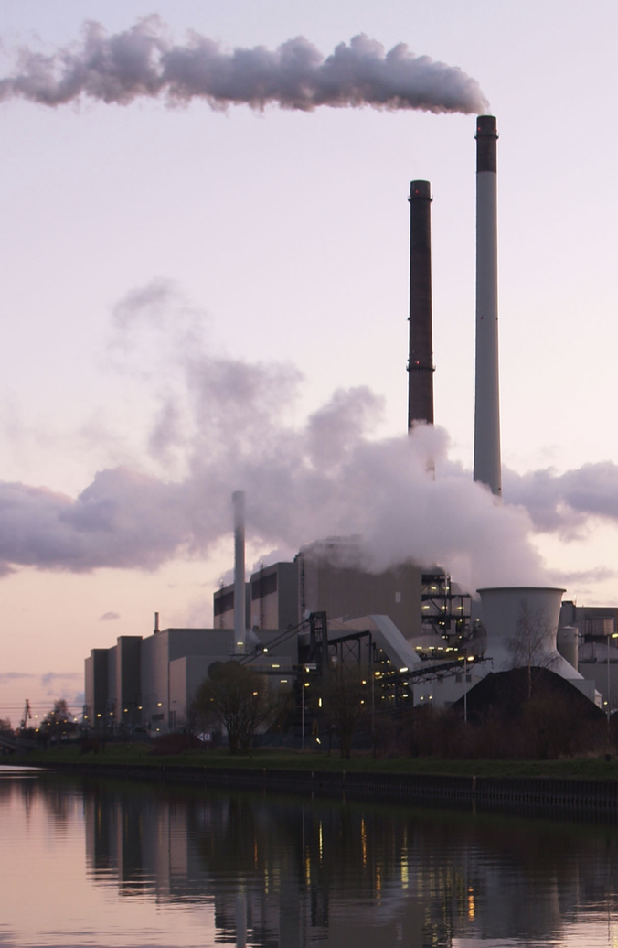
Imbalances = Disturbances
Ecosystem disturbances occur any time there are imbalances in matter and energy.
  Changes in matter and energy must be equal and balanced for ecosystems to function.
On a global scale, CO₂ production now exceeds the absorption of CO₂.
  This imbalance is affecting ecosystems throughout the world.
  This imbalance is due to widespread fossil fuel combustion.
Source: Wikipedia

Slide 9
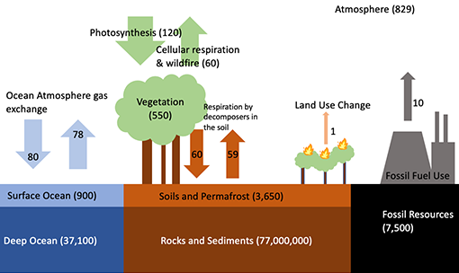
Source: Carbon TIME
This shows the movement of carbon atoms through photosynthesis, respiration, decomposition, and combustion. Because of fossil fuel combustion, more CO₂ is released than can be absorbed through photosynthesis. This creates imbalances that disrupt ecosystems.

Slide 10
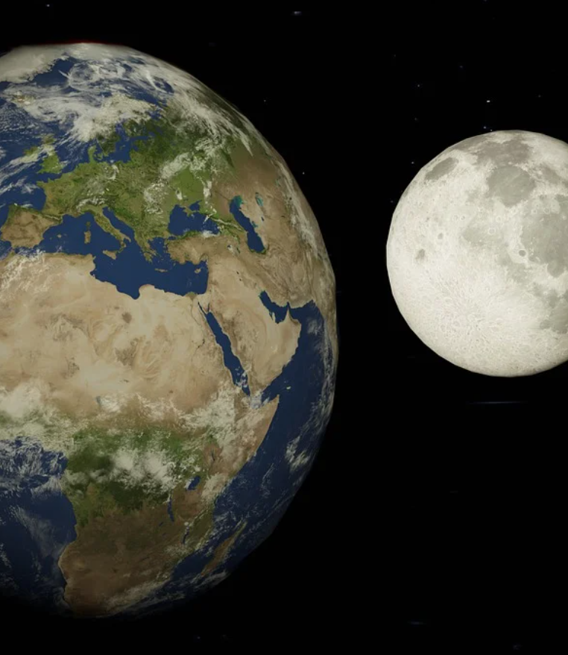
CO₂ = Temp Regulator
Image Source: Pixabay
Gases like CO₂ slow the loss of heat.
  This regulates the earth’s surface temperatures and enables life to exist.
Without moderate levels of CO_{2,} life could not exist on earth.
  Case in point: earth and the moon are the same distance from the sun but have very different surface temperatures.
  The moon ranges from -300º F to 225º F due to a lack of gases like CO₂.
Due to its small size, the moon
lacks an atmosphere with CO₂.
As a result, temps on the moon
fluctuate between -300º – 225º F

Slide 11
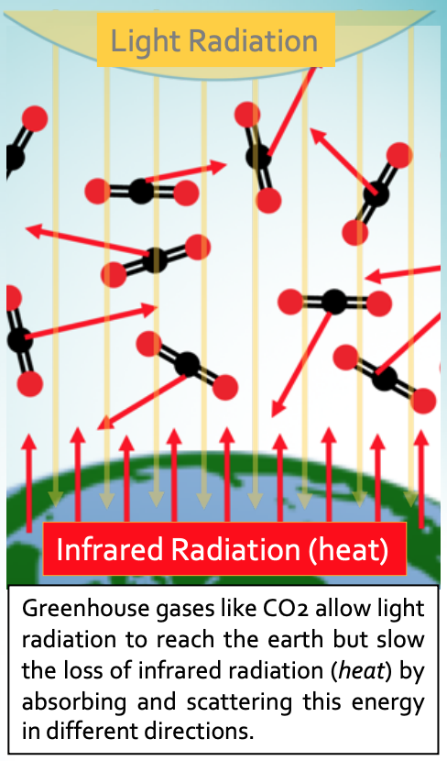
Greenhouse Gases (GHG’s)
Greenhouse gases like CO₂ allow light to reach the surface of the earth but slow the loss of heat energy.
  This is known as the greenhouse effect.
  The greenhouse effect explains why a car warms up on a sunny day – light can enter through glass more easily than heat can escape.
CO₂ is only a small proportion of the earth’s atmosphere, but it is the most abundant greenhouse gas (GHG).
  Changing CO₂ levels have global impacts on temperature and cause widespread disruptions to ecosystem function.

Slide 12
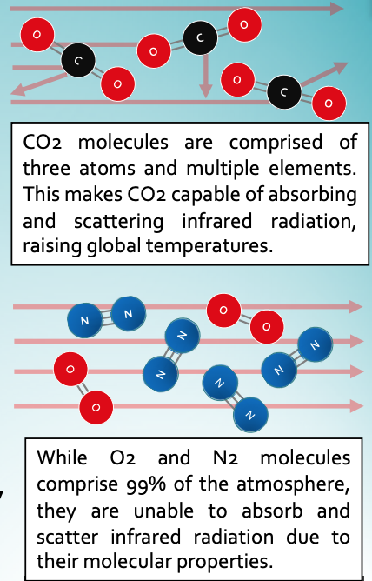
Absorbing & Re-emitting Heat
  Greenhouse gases absorb and scatter infrared radiation (energy we feel as heat).
  To be a greenhouse gas, a molecule must have…
  A) three or more atoms.
  B) two or more elements.
  The molecular structure of CO₂ enables it to absorb infrared radiation and re-emit it.
  The greater the concentration of CO₂, the more slowly heat escapes into space.
  The higher the concentration of CO₂, the more that global temperatures increase.
Notes:
Water vapor is also a greenhouse gas. However, water stays in the atmosphere for far less time than CO2. As such, our emphasis in this presentation is on CO2 due to its role as the primary greenhouse gas in the atmosphere.

Slide 13
Just a Natural Cycle?
Milankovitch Cycles
The changes occurring today are far too rapid to be the result of natural cycles.
  Variations in the Earth’s orbit and tilt (called Milankovitch Cycles) affect how much solar energy reaches the earth.
  This affects global temperatures.
  The length of these cycles occur range from 20,000 - 100,000 years.
Current changes to climate have occurred in less than 200 years.
  This warming is occurring far more quickly than what occurs through natural cycles.
Circular Orbit vs. Oval Orbit
Cycles last 100,000 years.
Less Axial Tilt vs. More Axial Tilt
Cycles last 41,000 years.
Less Wobble vs. More Wobble
Cycles last 26,000 years.

Slide 14
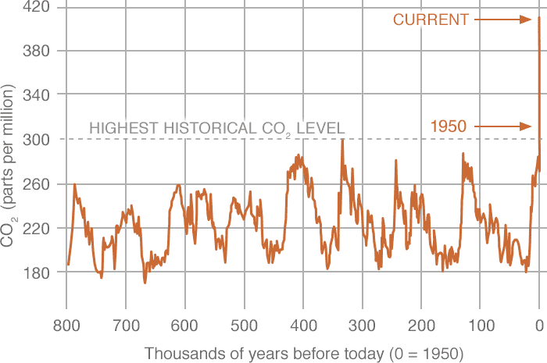
Unprecedented Spikes in CO2
Atmospheric CO₂ levels have increased by more than 50% since the Industrial Revolution mostly because of fossil fuel combustion.
  Humans have never experienced another time in which CO₂ concentrations were this high or increased at this rate.
Source: NASA Climate Change
Notes:
It can be helpful to point out that anatomically modern humans as a species are roughly 200,000 years old. The data above gives us a snapshot for what “natural” variations in CO2 look like. With or without modern humans, CO2 levels never exceeded 300 ppm prior to the Industrial Revolution.

Slide 15
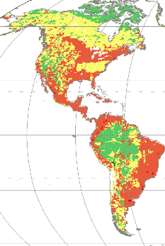
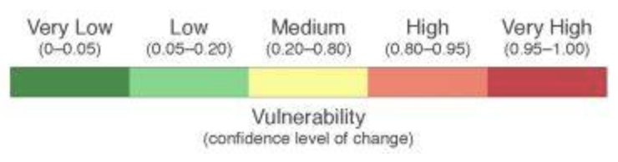
Ecosystem Disturbances
Changes from rising CO₂ levels are causing global ecosystem disturbances.
  Climate change refers to ecological disturbances caused by rising CO₂ levels from human activities.
  For example, a warming climate changes the kinds of plants that can live in an area.
    This displaces the animals that depend on that vegetation.
Some species are directly impacted by climate change.
  For example, salmon & trout need cool water as warm water has less oxygen.
  As their habitats warm, oxygen availability is reduced.
  Most of North American habitats
  are threatened by climate change.
Source

Slide 16
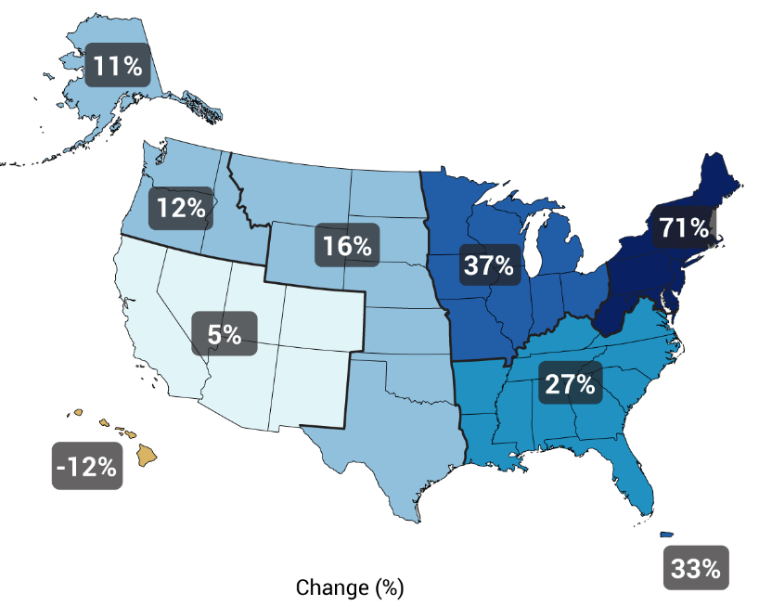
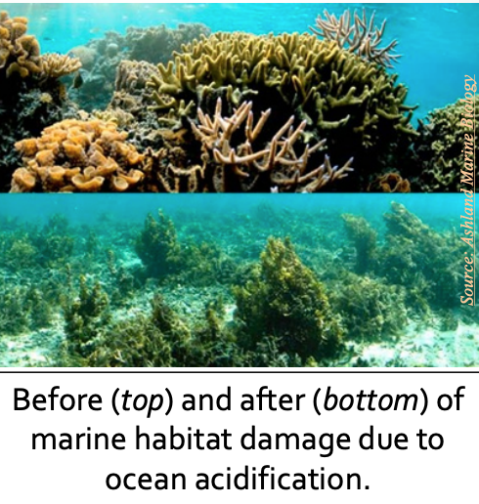
Flooding, Droughts, & Acidity
Source: National Climate Assessment - GlobalChange.gov
Increasing greenhouse gases also change precipitation patterns.
  A warmer atmosphere can hold onto more moisture for longer timeframes.
  This increases the frequency of both droughts and flooding.
Increasing CO₂ levels also threaten ocean ecosystems.
  As CO₂ dissolves in water, it forms carbonic acidic; this dissolves coral reefs.
  This can have significant ramifications as most photosynthesis (70%) occurs in aquatic ecosystems.
Changes in Heavy Precipitation
Source: FACTS
Notes:
70% of photosynthesis occurs in marine plants - https://www.nationalgeographic.org/activity/save-the-plankton-breathe-freely/

Slide 17
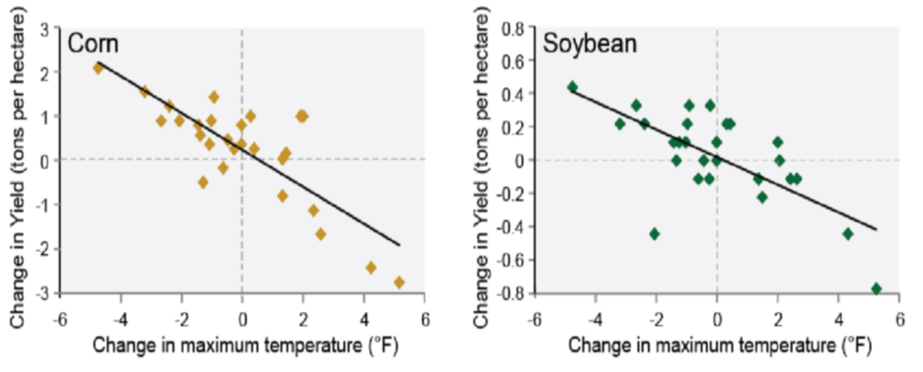
Impacts on Agriculture
  Rising CO₂ levels impact a wide variety of human activity, particularly agriculture.
    Increasing summer temperatures by a couple degrees reduces corn yields by 1-3 tons per acre (see data →). (Pryor et al., 2014)
    The US dairy industry loses $670 million annually from increasing temps. (Mauger et al., 2015)
    Lengthening the summer growing season by a single day results in a 7.6% reduction in wheat production. (Tack et al., 2015)
    Early thaws cause hundreds of millions of dollars in losses to fruit & berry crops.
    (Hatfield & Tackle, 2014)
Warmer summer temps cause major reductions in crop production.
(Pryor et al., 2014)

Slide 18

Revising Our Claims
Re-visit your ideas about our questions.
How do imbalances in matter and energy cause ecosystem disturbances?
How do ecosystems enable matter movement and energy transformation?
How do imbalances in matter and energy occur?
What happens when matter and energy are unbalanced?
How does human activity relate to these kinds of disturbances?

Slide 19
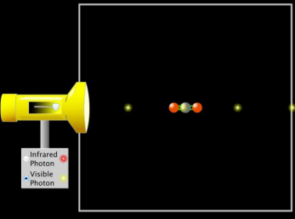
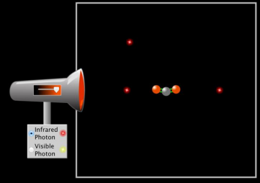
Looking Ahead: Part 3 Investigation
In Part 3, you will use a computer simulation to investigate how different kinds of energy (radiation) interact with GHG’s.

Slide 20
Key Points
Imbalances in the movement of matter and/or the flow of energy can result in disturbances to ecosystem function.
  The extinction of the dinosaurs is an example; dust clouds interrupted photosynthesis, reducing carrying capacities of ecosystems, resulting in mass extinction.
Currently, there is in imbalance in the movement of carbon atoms.
  The release of CO₂ through fossil fuel combustion exceeds the rate of absorption of CO₂ through photosynthesis.

Slide 21
Key Points
Greenhouse gases like CO₂ allow light to pass through but slow the loss of infrared radiation (heat energy).
  This is called the greenhouse effect.
CO₂ helps to moderate the temperature of the earth.
  However, excess greenhouse gases disrupt ecosystems.
CO₂ is the most abundant greenhouse gas.
  More abundant gases like N₂ and O₂ are unable to interact with infrared radiation due to the molecular properties.
  Because CO2 has more than 3 atoms and more than 2 elements, it can slow the loss of infrared radiation.

Slide 22
Key Points
  The greater the concentration of CO₂, the more slowly heat escapes into space.
    CO2 levels are now increasing at an unprecedented pace.
Recent warming trends are not part of a natural cycle.
  Milankovitch Cycles occur over 20,000-100,000 years.
  Modern warming has occurred in less than 200 years.
Rising CO₂ levels disrupt ecosystem, by changing vegetation, reducing oxygen/increasing acidity in aquatic ecosystems, and increasing flooding and droughts.
  Increasing CO₂ levels also reduce agricultural production.

