Slide 1
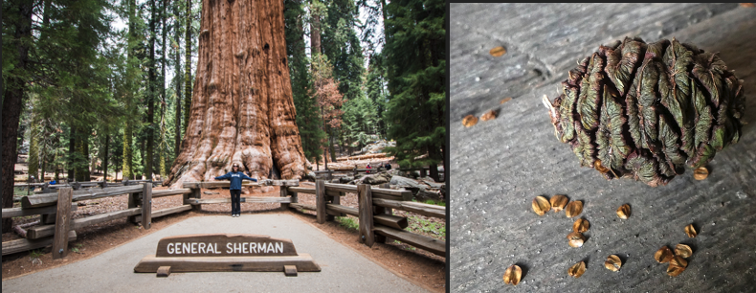
WUHS Biology: Plants Unit
Image Source
Packet 1 – How do plant cells differ from animal cells?

Slide 2
Plants Unit – Packet 1 Driving Question
Driving Question: How do plant cells differ from animal cells?
How do plants move substances to their cells without a heart?
How do plants stay upright without a skeleton?
How do plants acquire glucose needed for cell respiration?

Slide 3
Part 1 Recap
Image Source
Earlier we learned that the General Sherman is the largest tree in the world, weighing 5.6 million kg. We also learned that sequoia seed only weighs 0.005 g.
Where did the millions of kilograms of atoms come from?

Slide 4
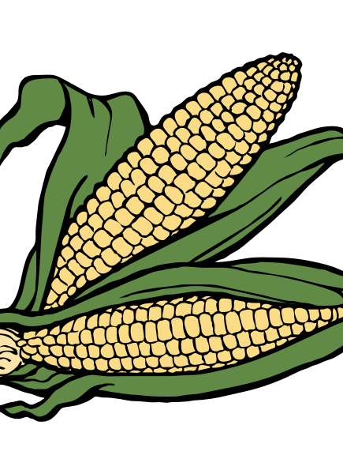
Introducing: Plants!

Slide 5
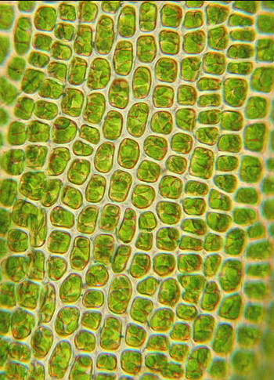
Cells
Like animals, plants are living organisms that are composed of cells.
Plant and animal cells function in many similar ways and are composed of many of the same macromolecules.
Plant cells also contain a fatty membrane on the outside and protein-based structures on the inside.
Similarly, plant cells can grow and expand over time.
Plant cells must also acquire fats and proteins to build and repair their cells.
Plant cells also can divide through the process of mitosis to form two cells.
Image Source
Image Source

Slide 6
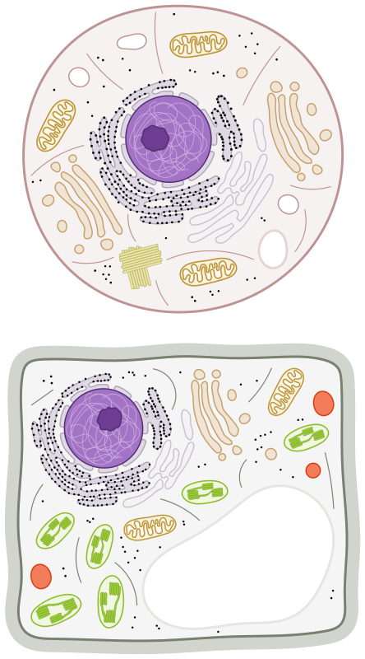
Cells
Animal cell
Image Source
Plant cells contain most of the same organelles found in animal cells.
Plant cells also store their DNA in a nucleus.
Plant cells also have ribosomes to assemble proteins during biosynthesis.
Like animals, plant cells must also perform cellular respiration.
Plant cells also have mitochondria where glucose and oxygen rearrange to form CO₂ and H₂O.
Plant cells also use ATP like a “rechargeable battery” for their cells.
They use the chemical energy from glucose to “recharge” ATP during cellular respiration.
Mitochondria
Nucleus
Ribosomes
Plant cell
Image Source

Slide 7
Plant Cell Walls
Image Source
Animal cell
There are a few key differences between plant and animal cells.
In particular, plant cells have three key organelles that are not found in animal cells.
These include cell walls, vacuoles, and chloroplasts.
The cell wall is a tough outer “shell” that coats the cell membrane.
The cell wall acts like the “skeleton” of the plant.
The cell wall gives plants their shape and rigidity (similar to how a skeleton supports the bodies of many animals).
The cell wall is made from cellulose.
Cellulose is a long rigid chain of glucose molecules.
Mitochondria
Ribosome
Nucleus
Cell Wall
Vacuole
Chloroplast
Plant cell

Slide 8
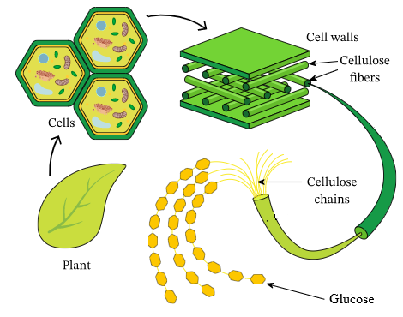
Cellulose
Image Source
Cellulose is a type of carbohydrate.
Cellulose is made from long chains of glucose.
Cellulose forms cell walls that provide plants with structure & rigidity.

Slide 9
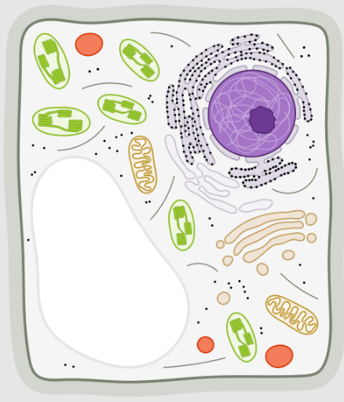
Plant Vacuoles
Image Source
The vacuoles of plant cells are storage organelles.
Plant cells store excess water in their vacuoles for use during dry periods.
The vacuole also stores waste products from plant cells.
Most animals have organs like the kidney and liver to remove waste products.
However, plant cells store waste products in the vacuoles of their cells (like a garbage dump).
Vacuole
The vacuoles of plant cells store water and waste products of the cell.

Slide 10
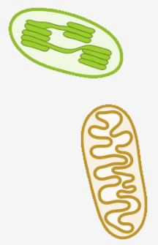
Chloroplasts
CO₂
H₂O
CO₂
H₂O
The chloroplast is the organelle that produces glucose molecules.
The chloroplast uses light energy (like sunlight) to rearrange the atoms in water and carbon dioxide to form glucose and oxygen (O₂).
The process in which plants produce glucose and oxygen from CO₂ and H₂O is known as photosynthesis.
Most of the glucose and oxygen produced in the chloroplast are moved to the mitochondria.
The mitochondria then rearranges the atoms in glucose and oxygen to form CO₂ and H₂O.
This process (cell respiration) recharges the ATP needed to power plant cells.
Plant cells can also assemble glucose into long chains to form cellulose.
This makes up most of the mass of the plant.
Mitochondria
O₂
Glucose
Chloroplast

Slide 11
How do plants get their food?
If plants don’t eat, how do their cells get carbs, fats, and proteins?

Slide 12
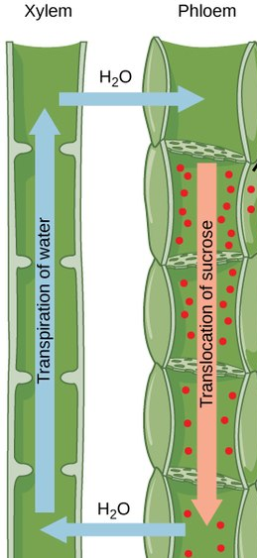
Plant Cells, Tissues, and Organs
Plant cells are organized like animal cells.
Multiple plant cells form tissues.
Tissues form organs in plants, such as roots, stems and leaves.
These organs are a part of systems that comprise the plant.
Two kinds of plant tissue called xylem and phloem are especially important to the function of the plant.
Xylem (“ZY-lem”) consists of long “tubes” of cells that enable a plant to move water and minerals from the roots to its leaves.
Phloem (“FLO-em”) forms long tubes of cells that move needed molecules (like glucose) down from the leaves to other parts of the plant.
Image Source

Slide 13
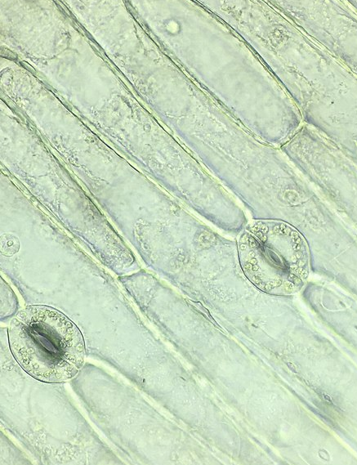
Fluid Movement in Plants
Image Source
Evaporation and gravity are needed to move substances throughout the plant.
Plants do not have a pumping organ (like a heart) to move substances throughout their bodies.
Instead, plants use evaporation from their leaves to move water and minerals up the xylem.
The leaves of most plants have pores that allow water to evaporate.
As water evaporates, it pulls water upward through the xylem tubes of the plant.
The pores in leaves also allow for absorption of the carbon dioxide.
This CO₂ is needed for glucose production.
The pores of leaves allow water evaporation and absorption of carbon dioxide.

Slide 14
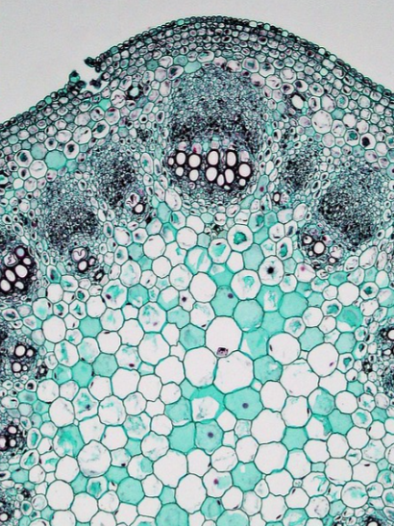
Leaves = Glucose Factories
Image Source
Phloem
Only plant cells with access to light (like those in the leaves) can perform photosynthesis.
Cells that lack access to light (such as root cells) depend on leaf cells to produce the glucose needed for cellular respiration.
The movement of fluids through xylem and phloem ensure that all cells in the plant have access to needed molecules such as glucose.
Leaves are like factories for glucose production.
The xylem is like a highway that delivers some of the needed materials to produce glucose.
The phloem is like a highway that delivers glucose to other cells in the plant.
Xylem
This image shows xylem and phloem. Xylem moves water and minerals up to the leaves. Phloem moves glucose and other molecules down to other cells that cannot photosynthesize.

Slide 15
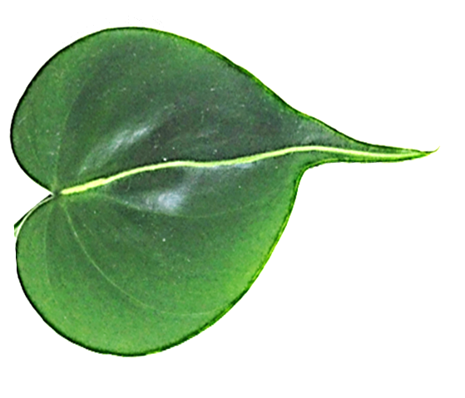
Summary
CO₂
1. Evaporation pulls water up the xylem tubes into the leaves of the plant.
2. CO₂ is absorbed through pores in the leaves.
3. CO₂ and H₂O are rearranged to form glucose and oxygen using light energy.
4. Glucose is used for cell respiration or biosynthesis.
2
O₂
1
`
3
Xylem
Glucose
4
`
H₂O
`
Phloem

Slide 16
Plants Unit – Packet 1 Driving Question
Image Source
Are we better able to answer these questions with this new info?
Driving Question: How do plant cells differ from animal cells?
How do plants move substances to their cells without a heart?
How do plants stay upright without a skeleton?
How do plants acquire glucose needed for cell respiration?

Slide 17
Looking Ahead: Part 3 Investigation
In Part 3, you will be conducting two investigations.
In 3A & 3C, you will compare how levels of CO₂ change depending on if plants are in the light or the dark.
In 3B, you will determine the difference in mass between seeds and seedlings.

Slide 18
Key Points
Plants are living organisms that are composed of cells.
Plant and animal cells are composed of many of the same macromolecules and organelles (like a nucleus, ribosomes, and mitochondria).
Plant cells must also perform cellular respiration to recharge their ATP.
Plant cells have three key organelles not found in animal cells.
These include cell walls, vacuoles, and chloroplasts.
The cell wall is a tough outer shell made from cellulose.
Cellulose is a type of carbohydrate made from long chains of glucose.
The cell wall acts as the “skeleton” of the plant.
The vacuoles of plant cells are storage organelles.
Plants store water and keep waste products in their vacuoles.

Slide 19
Key Points
The chloroplast is the organelle that produces glucose molecules.
The chloroplast uses light energy (like sunlight) to produce glucose and oxygen from CO₂ and H₂O in a process known as photosynthesis.
Most of the glucose and oxygen produced in the chloroplast are moved to the mitochondria for cellular respiration to recharge ATP.
Like animals, plant cells are organized into tissues, organs, and systems.
Plant tissues called xylem and phloem are especially important to the function of the plant.
Xylem consists of long tubes of cells that use evaporation to move water and minerals upward from the roots to its leaves.
Phloem forms long tubes of cells that use gravity to move molecules like glucose down from the leaves to other cells for respiration and biosynthesis.

Slide 20
Key Vocab
Cell Wall: a tough outer shell of cellulose that coats the plant cell membrane.
Cellulose: a long rigid chain of glucose molecules.
Vacuoles: storage organelles for plant cells.
Chloroplast: organelle in plant cells that produces glucose molecules during photosynthesis.
Photosynthesis: the cellular process in which plants produce glucose and oxygen from CO₂ and H₂O.
Xylem: long tubes of cells that use evaporation to move water and minerals upward from the roots to its leaves.
Phloem: long tubes of cells that use gravity to move molecules like glucose down from the leaves to other cells for respiration and biosynthesis.

