Slide 1
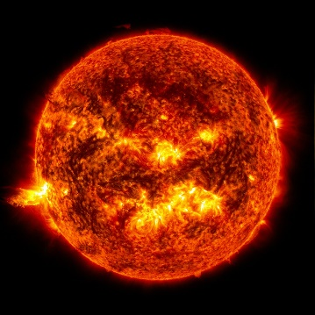
How the Sun Works Unit Week 3 – How can we measure the sun?

Slide 2
Sun Unit – W3 Driving Question
This week’s driving question: How can we measure the sun?
How can we determine the distance between the sun and the earth?
How can we determine the size of the sun?
How can we determine the temperature of the sun?

Slide 3
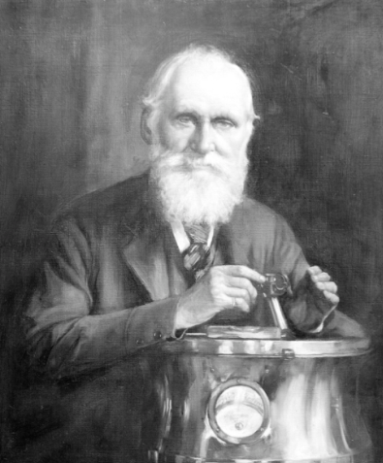
Week 2 Recap
Last week we determined that the sun is primarily composed of hydrogen and helium.
However, we still haven’t answered our original question – how can the Sun burn continuously for more than a few tens of millions of years at most without exhausting its fuel?
Maybe you can do better than Lord Kelvin?

Slide 4
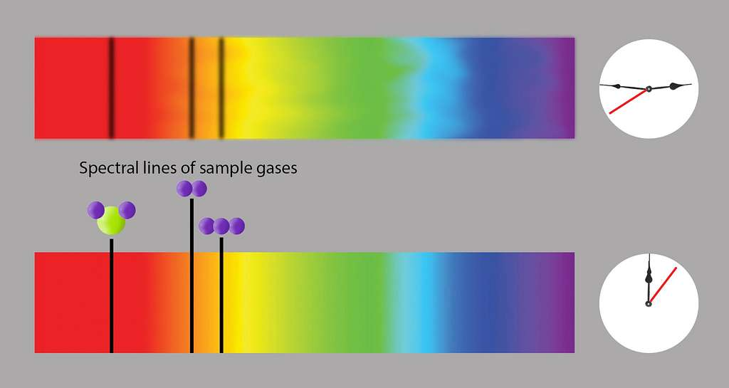
Studying Sunlight
Spectral analysis provides us with most of what we know about the sun and other stars.
Spectral analysis can tell us the kinds of elements that comprise the sun, among other information.
However, we still need more information to determine how the sun actually produces heat and light.

Slide 5
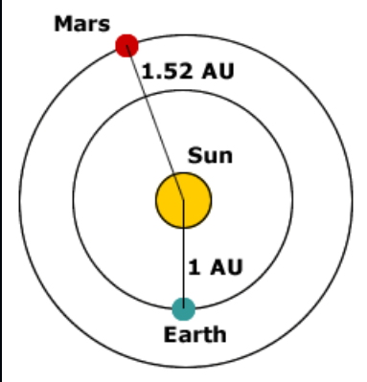
Distance to the Sun
Astronomers were able to determine the distance between the earth and the sun in 1771.
They were able to determine this distance (known as an astronomical unit, or AU) long before spaceflight was a possibility using what is known as a parallax.
A parallax is when the position of an object appears different when viewed from different positions.
For example, if you hold your index finger at arm’s length, it appears to change position if you view it from your left eye and then your right eye.
Source: http://blogstronomy.blogspot.com/2009/08/what-is-astronomical-unit-au.html

Slide 6
Distance to the Sun
In 1761 and 1769, Venus provided a metaphorical finger that could be used to measure an AU.
Venus makes predictable transits across the sun (i.e., it appears to pass directly across the sun).
By precisely timing the length of time that Venus spent travelling across the sun from different locations on the planet, astronomers could infer the distance of an AU.

Slide 7
Parallax & Transit of Venus

Slide 8
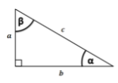
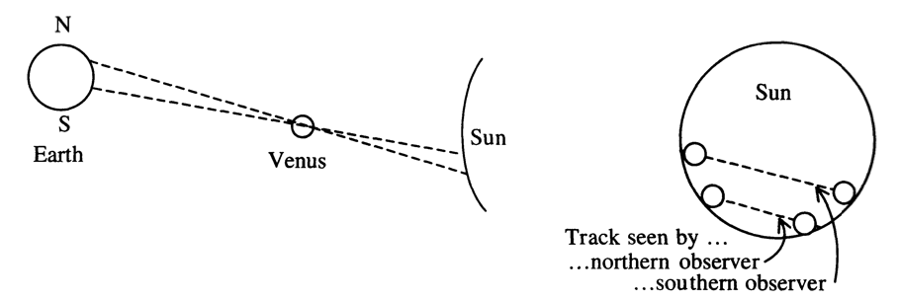
The Rest is Just Math
Trigonometry is key for determining the size of the AU.
If you can determine the size of ⍺ (the angle between lines drawn from both the equator and north pole to the sun), and the radius of the earth you can use trigonometry to determine AU (shown as A below).
AU = r_{e} * tan (90-⍺)
b = a * tan(β) β = 90 - ⍺
Source: https://www.maa.org/sites/default/files/pdf/pubs/mm_dec03-Venus.pdf
Notes:
As expected, the realities of acquiring and processing this data was far more complicated than described here. A great summary of this global scientific endeavor can be found at https://www.maa.org/sites/default/files/pdf/pubs/mm_dec03-Venus.pdf

Slide 9
How Big is the Earth?
Trigonometry also was useful for determining the size of the earth… as early as 200 B.C.E.
Greek mathematician Eratosthenes observed that on the summer solstice at noon, the sun’s reflection was visible at the bottom of a deep well in Syene.
This meant the sun had to be directly overhead (90º)
Eratosthenes realized that this created a right triangle that could be used to determine the circumference and radius of the earth.
Angle of shadow in City 2 = Distance between Cities 1 & 2 360º Circumference of Earth
Source: https://www.maa.org/sites/default/files/pdf/pubs/mm_dec03-Venus.pdf

Slide 10
Determining the Size of the Earth
Eratosthenes knew that the distance between Syene and Alexandria was 926 km.
He measured the angle of a shadow at noon in Alexandria to be 7.2º
7.2/360 = 0.02
0.02 x 926 km = 46,300 km (the actual size is 40,007.9 km)
Notes:
Eratosthenes actually measured the distance between Syene and Alexandria in stades. This was converted to km for the purpose of this presentation. 5000 stades = 926 km. A summary of this work can be found at https://www.aps.org/publications/apsnews/200606/history.cfm If you want to try this for yourself, and you’re within 2 weeks of an equinox (spring or fall), visit https://www.scientificamerican.com/article/measure-earths-circumference-with-a-shadow/

Slide 11
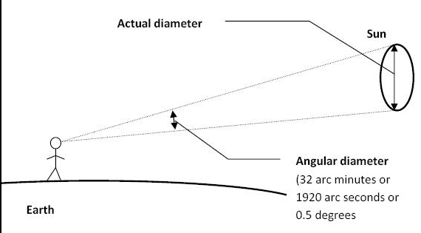
Calculating the Sun’s Size
Once you know the distance of an AU, you can also determine the radius of the sun.
R_{sun} = d * tan (a/2)
d = 150,000,000 km a = 1920 arc seconds (or 0.5º) R_{sun} = 150,000,000 x tan (0.5/2) R_{sun} = 700,000 km.

Slide 12
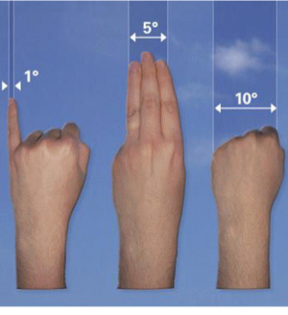
What is an Arcsecond?
Our visible sky creates perfect circle from our perspective.
Every circle has 360 degrees, which simplifies astronomical equations
Each degree has 60 arcminutes
Each arcminute has 60 arcseconds.
Each degree (1/360th of the sky) contains 3600 arcseconds.
The sun’s size from our perspective equals 1920 arcseconds of the sky.
Knowing this size as well as the length of an AU, we can determine the sun’s radius is 700,000 km.
Holding your hands out at arm’s length provides a quick measure of degrees (e.g., your pinky = 1/360th of the sky).
Source: https://earthsky.org/astronomy-essentials/sky-measurements-degrees-arc-minutes-arc-seconds/

Slide 13
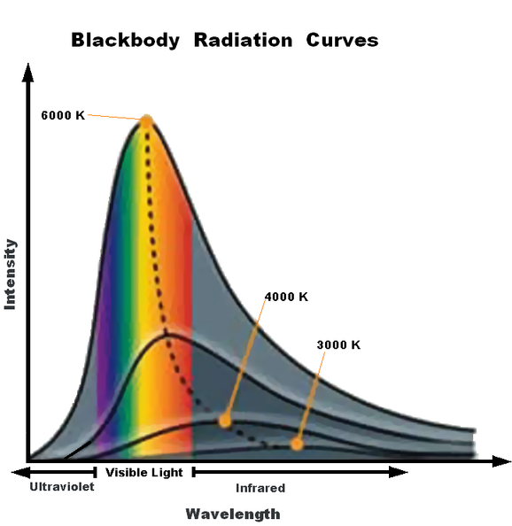
Taking the Sun’s Temperature
If we know the sun’s size and temperature, we can begin to determine how the sun functions.
We can determine the sun’s temp (or any star’s temp) using a blackbody radiation curve.
This refers to how particular objects emit radiation as they are heated.

Slide 14
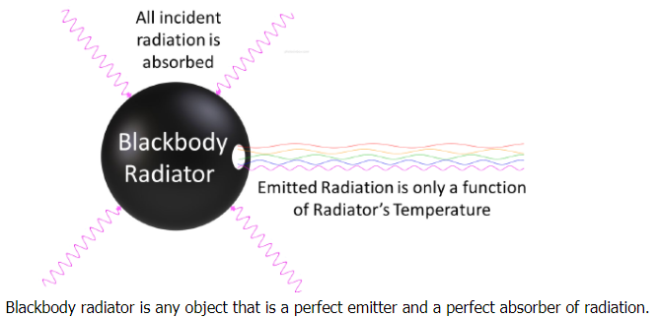
Taking the Sun’s Temperature
A blackbody is an object that absorbs all radiation that reaches it.
When blackbody objects are heated, they reemit radiation in a predictable pattern.
This radiation will produce a particular color based on the temperature of the object when viewed through specialized filters.
Source: https://chem.libretexts.org/Courses/Pacific_Union_College/Quantum_Chemistry/01%3A_The_Dawn_of_the_Quantum_Theory/1.01%3A_Blackbody_Radiation_Cannot_Be_Explained_Classically

Slide 15
Photometry
A star’s temperature can be determined by comparing the light received through these filters.
This process is called photometry, which is different from spectral analysis.
Surface Temp (K) | Color | Example
30,000 | Blue-violet | Mintaka
20,000 | Blue | Rigel
10,000 | White | Vega, Sirius
7000 | Yellow-White | Canopus
6000 | Yellow | Sun, Alpha Centauri
4000 | Orange | Arcturus, Aldebaran
3000 | Red | Betelgeuse, Barnard’s

Slide 16
Looking Ahead
We now know key pieces of information, including:
The size of an AU (from parallax calculations).
The size of the sun (using the AU and arcseconds).
The temp of the sun (using photometry).
This info enables us to determine the kinds of activity that occur at the atomic and subatomic levels inside the sun.
This will help us to determine how the sun can burn continuously for billions of years.

Slide 17
Revisions to W3 Driving Question
Can we now improve our answers to our driving questions?
How can we measure the sun?
How can we determine the distance between the sun and the earth?
How can we determine the size of the sun?
How can we determine the temperature of the sun?

